Slide 1

CPUC Public Agenda 3337
Thursday, June 12, 2014, 9:30 a.m.
San Francisco, CA
Commissioners:
Michael R. Peevey
Michel Peter Florio
Catherine J.K. Sandoval
Carla J. Peterman
Michael Picker
www.cpuc.ca.gov

Slide 2
Safety and Emergency Information
The restrooms are located at the far end of the lobby outside of the security screening area.
In the event of an emergency, please calmly proceed out of the exits. There are four exits total. Two exits are in the rear and two exits are on either side of the public speakers area.
In the event of an emergency and the building needs to be evacuated, if you use the back exit, please head out through the courtyard and down the front stairs across McAllister.
If you use the side exits you will end up on Golden Gate Ave. Please proceed around the front of the building to Van Ness Ave and continue on down to the assembly point.
Our assembly point is between the War Memorial Building and the Opera Building (House) which is on Van Ness Ave, located between McAllister and Grove.

Slide 3
Public Comment
Per Resolution ALJ-252, any member of the public who wishes to address the CPUC about matters before the Commission must sign up with the Public Advisor’s Office table before the meeting begins. If an individual has signed up using the electronic system on the Commission’s website, they must check in with the Public Advisor’s Office on the day of the meeting, by the sign-up deadline.
Once called, each speaker has up to 3 minutes at the discretion of the Commission President, depending on the number of speakers the time limit may be reduced to 1 minute.
A sign will be posted when 1 minute remains.
A bell will ring when time has expired.
At the end of the Public Comment Section, the Commission President will ask if there are any additional individuals who wish to speak. Individuals who wish to speak but did not sign up by the deadline, will be granted a maximum of one minute to make their comments.
The following items are NOT subject to Public Comment:
  Items: 33, 36, and 42.
  All items on the Closed Session Agenda

Slide 4
Public Comment
Per Resolution ALJ-252, any member of the public who wishes to address the CPUC about matters before the Commission must sign up with the Public Advisor’s Office table before the meeting begins. If an individual has signed up using the electronic system on the Commission’s website, they must check in with the Public Advisor’s Office on the day of the meeting, by the sign-up deadline.
Once called, each speaker has up to 2 minutes to address the Commission.
A sign will be posted when 1 minute remains.
A bell will ring when time has expired.
At the end of the Public Comment Section, the Commission President will ask if there are any additional individuals who wish to speak. Individuals who wish to speak but did not sign up by the deadline, will be granted a maximum of one minute to make their comments.
The following items are NOT subject to Public Comment:
  Items: Items: 33, 36, and 42.
  All items on the Closed Session Agenda

Slide 5
Public Comment
Per Resolution ALJ-252, any member of the public who wishes to address the CPUC about matters before the Commission must sign up with the Public Advisor’s Office table before the meeting begins. If an individual has signed up using the electronic system on the Commission’s website, they must check in with the Public Advisor’s Office on the day of the meeting, by the sign-up deadline.
Once called, each speaker has up to 1 minute to address the Commission.
A bell will ring when time has expired.
At the end of the Public Comment Section, the Commission President will ask if there are any additional individuals who wish to speak. Individuals who wish to speak but did not sign up by the deadline, will be granted a maximum of one minute to make their comments.
The following items are NOT subject to Public Comment:
  Items: Items: 33, 36, and 42.
  All items on the Closed Session Agenda

Slide 6
Agenda Changes
Items shown on the Consent Agenda will be taken up and voted on as a group in one of the first items of business of each CPUC meeting.
Items on Today’s Consent Agenda are: 1, 3, 4, 8, 10, 12, 15, 16, 17, 18, 20, 21, 22, 23, 24, 25, 26, 27, 28, 29, 30, 31, 33, 34, 35, 36, 37, 38, 39, 40, 41, 42, 43, 46, 49, 50, 52, 53, 54, 55, and 56.
Any Commissioner, with consent of the other Commissioners, may request an item from the Regular Agenda be moved to the Consent Agenda prior to the meeting.
Items: 61, 63m, 63s, and 63ag from the Regular Agenda have been added to the Consent Agenda.
Any Commissioner may request an item be removed from the Consent Agenda for discussion on the Regular Agenda prior to the meeting.
Item: None has been moved to the Regular Agenda.
Item: None has been withdrawn.
The following items have been held to future Commission Meetings:
Held to 6/26/14: 9, 13, 14, 19, 32, 44, 45, 47, 48, 51, 58, 58a, 59, 59a, 62, 62a, 63 with the exception of 63m, 63s, and 63ag, and 64.
Held to 7/10/14: 2, 5, 6, 7, 60, and 60a.
Held to 8/14/14: 11, and 11a.

Slide 7
Regular Agenda
Each item on the Regular Agenda (and its alternate if any) will be introduced by the assigned Commissioner or CPUC staff and discussed before it is moved for a vote.
For each agenda item, a summary of the proposed action is included on the agenda; the CPUC’s decision may, however, differ from that proposed.
The complete text of every Proposed Decision or Draft Resolution is available for download on the CPUC’s website: www.cpuc.ca.gov.
Late changes to agenda items are available on the Escutia Table.

Slide 8
Regular Agenda – Energy Orders
Item # 57 [12646] – Southwest Gas Corporation's Southern California, Northern California, and South Lake Tahoe Jurisdictions' General Rate Increases for Test Year 2014
A12-12-024 - Application of Southwest Gas Corporation for Authority to Increase Rates and Charges for Gas Service in California, Effective January 1, 2014.
Ratesetting Comr. Sandoval / Judge Kim
---------------------------------------------------------------------------------------------------------------------------------------------
PROPOSED OUTCOME:
Adopts test year 2014 general rate increases for Southwest Gas Corporation, as follows:
Increase of approximately $1,918,272 or 1.9 percent from currently authorized revenue in its Southern California rate jurisdiction.
Increase of approximately $2,522,973 or 8.5 percent from currently authorized revenues in its Northern California rate jurisdiction.
Increase of approximately $2,721,078 or 13.7 percent from currently authorized revenues in its South Lake Tahoe rate jurisdiction.
Authorizes the post-test year changes to rates and charges for years 2015 through 2018, to become effective on January 1 of each year, in each of the Company’s three California rate jurisdictions.
Approves Southwest Gas’ proposed Post Test Year Mechanism, proposed infrastructure Reliability and Replacement Adjustment Mechanism and a Conservation and Energy Efficiency Plan.
Closes the proceeding.
SAFETY CONSIDERATIONS:
Implement Customer-Owned Yard Lined program as recommended by the Commissions Safety and Enforcement Division to improve the public safety by testing and potentially replacing these underground pipes.
Allows the Commission to continue to fulfill its duties under Pub. Util. Code § 451, including to take all actions necessary to promote the safety, health comfort, and convenience of utility patrons, employees, and the public.
ESTIMATED COST:
Revenue requirement changes as described above.

Slide 9
Regular Agenda – Energy Orders
Item # 57a [12965] – ALTERNATE TO AGENDA ITEM 12646
A12-12-024 - Application of Southwest Gas Corporation for Authority to Increase Rates and Charges for Gas Service in California, Effective January 1, 2014.
Ratesetting Comr. Peevey
---------------------------------------------------------------------------------------------------------------------------------------------
PROPOSED OUTCOME:
Adopts test year 2014 general rate increases for Southwest Gas (SWG), as follows:
Increase of approximately $1,872,515 or 1.8 percent from currently authorized revenue in its Southern California rate jurisdiction.
Increase of approximately $2,514,501 or 8.4 percent from currently authorized revenues in its Northern California rate jurisdiction.
Increase of approximately $2,716,370 or 13.7 percent from currently authorized revenues in its South Lake Tahoe rate jurisdiction.
Adopts an attrition rate of 2.75%;
Authorizes a 50/50 allocation between ratepayers and shareholders for Supplemental Executive Compensation Retirement Plan and Executive Deferral Plan expenses;
Adopts a two-way balancing account for pension expenses;
Modifies the proposed Infrastructure Reliability and Replacement Adjustment Mechanism and the proposed Customer-Owned Yard Line Program;
Denies the proposed Aldyl-A pipe replacement acceleration.
SAFETY CONSIDERATIONS:
SWG has a comprehensive safety plan in place, including an Early Vintage Pipe Replacement Program.
SWG believes the system will continue to operate in a safe and reliable manner that meets or exceeds pipeline safety regulations.
ESTIMATED COST:
Revenue requirement changes as described above.

Slide 10
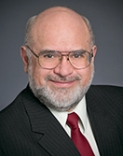
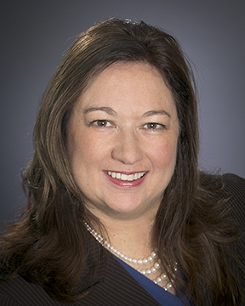
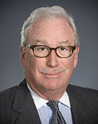
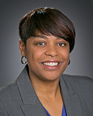
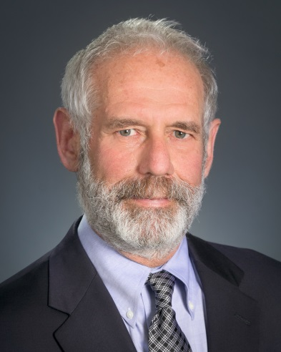
Commissioners’ Reports

Slide 11
Regular Agenda – Management Reports and Resolutions
Item #65 [ 13017 ] Commissioner Catherine J.K. Sandoval Report
Commissioner Sandoval’s Recommendations Seeking the Commission’s Approval of Appointments to Two Members to the Low Income Oversight Board.
------------------------------------------------------------------------

Slide 12

Commissioner Catherine J.K. Sandoval
California Public Utilities Commission
California High Cost A-Fund Public Participation Hearings Eureka to Yreka
May 2 to May 9, 2014

Slide 13
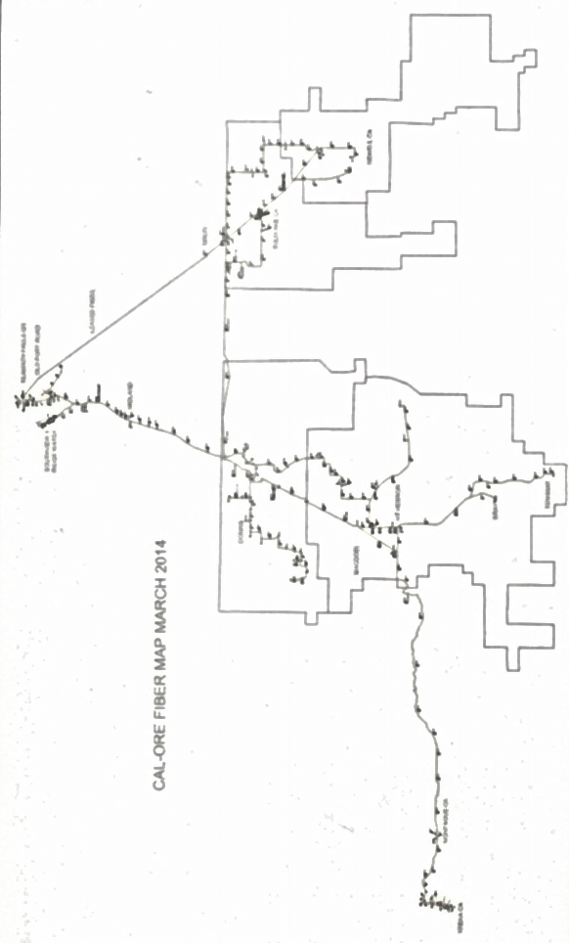
Klamath Falls, OR
Southview and Ridge Water
Old Fort Road
Leased Fiber
Midland
Malin
Dorris
Tulelake, CA
MacDoel
Newell, CA
Yreka, CA
Montague, CA
Bray
Tennant
CAL-ORE FIBER MAP MARCH 2014

Slide 14
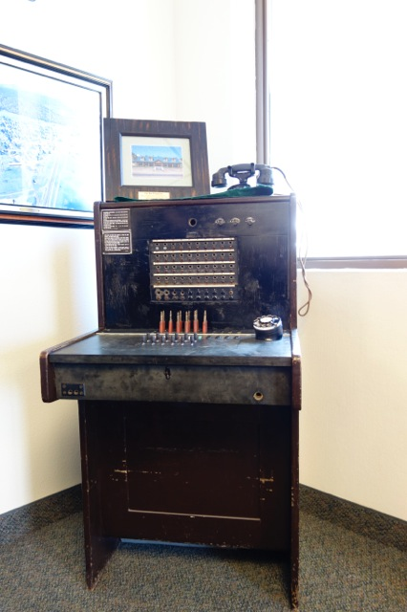
Cal-Ore Telephone

Slide 15
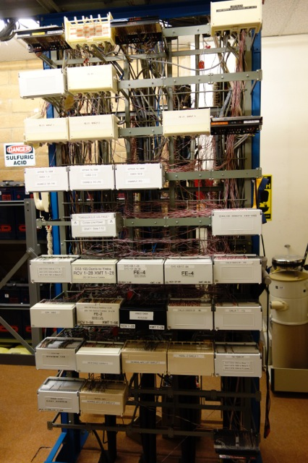
Cal-Ore Telephone, Tulelake C.O.

Slide 16
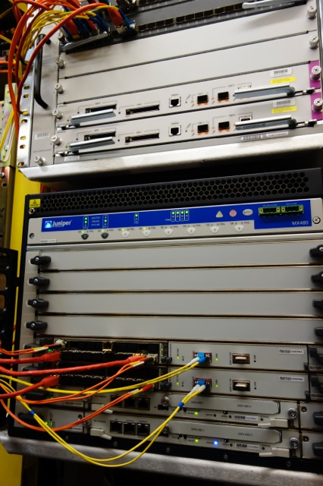
Cal-Ore Telephone

Slide 17
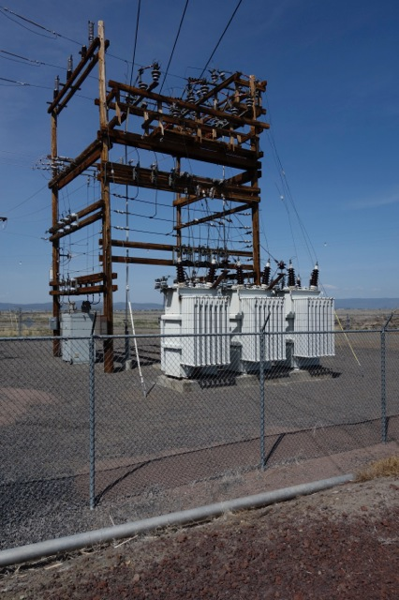
Power for Pumping, Lost River, Lower Klamath National Wildlife Refuge

Slide 18
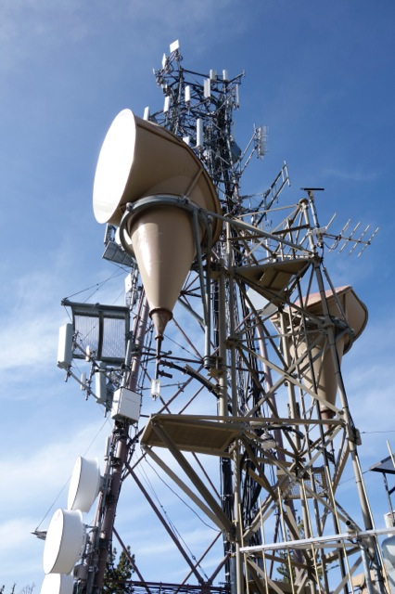
Cal-Ore Herd Peak Facility, Wireless Renters

Slide 19
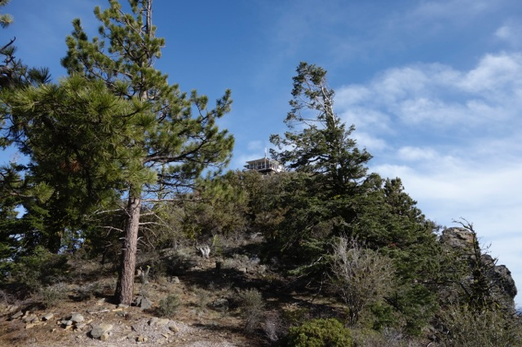
Herd Peak Fire Lookout Station

Slide 20
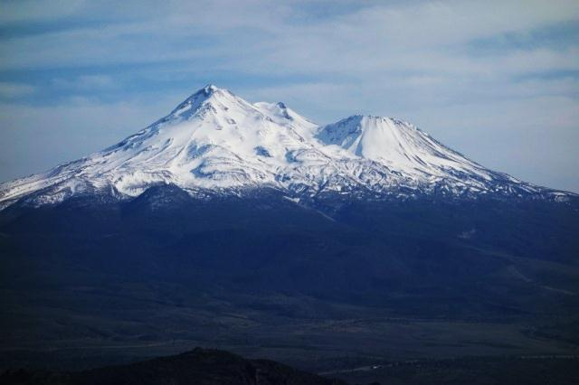
Mt. Shasta from Cal-Ore Facility on Herd Peak

Slide 21
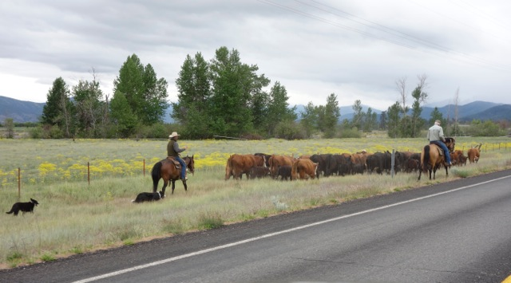
On the way to Siskiyou Telephone

Slide 22
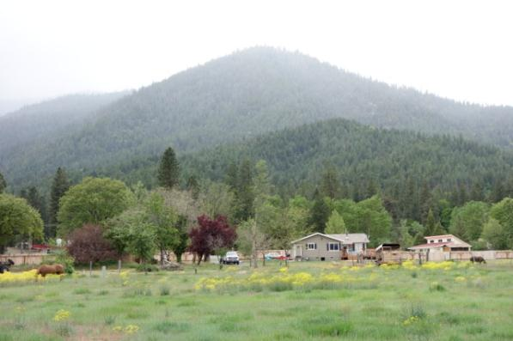
Siskiyou Telephone's front yard

Slide 23
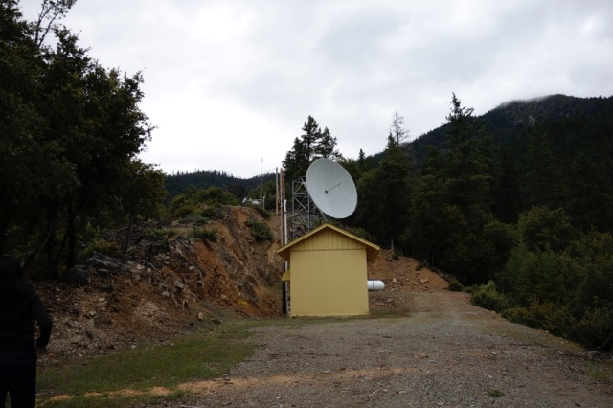
Siskiyou Microwave Facility Above Sawyer's Bar

Slide 24
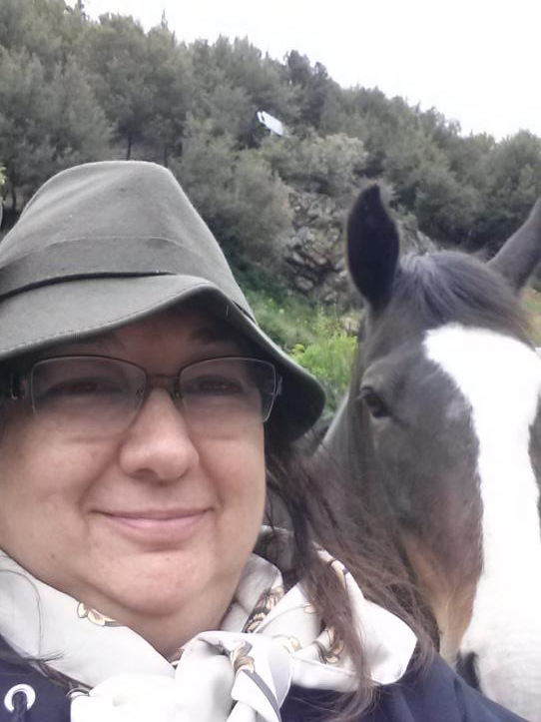
Looking at Siskiyou Telephone Facilities

Slide 25
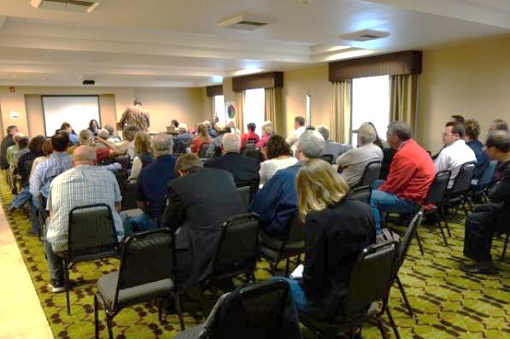
Yreka Public Participation Hearing

Slide 26
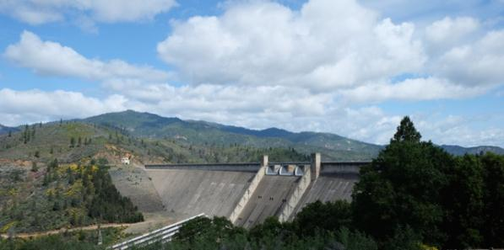
Shasta Dam

Slide 27
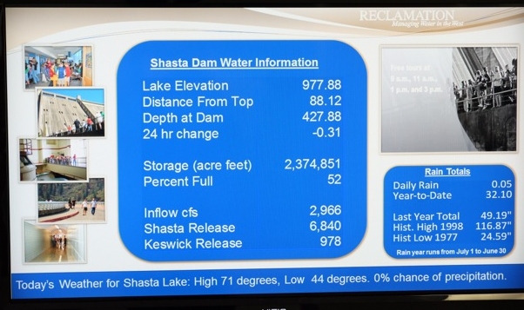
Shasta Dam Water Information –
"0% chance of precipitation."

Slide 28
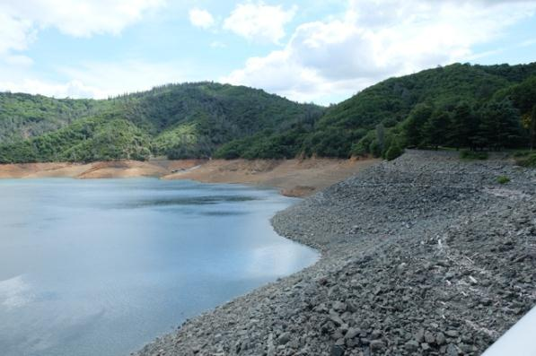
Water Level Down Some 88 feet (May 9, 2014)

Slide 29
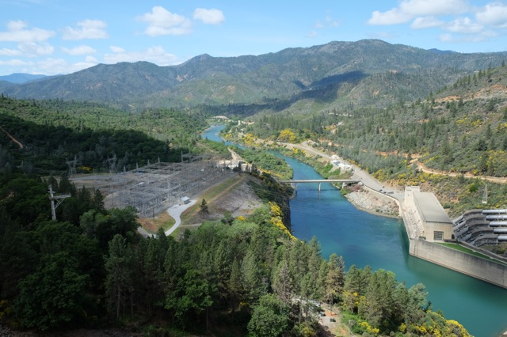
Shasta Dam Power Station

Slide 30
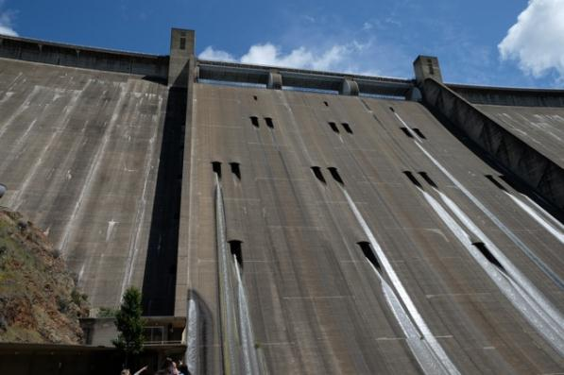
Shasta Dam

Slide 31
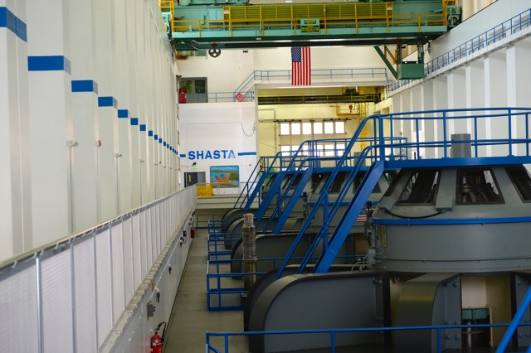
Shasta Dam Turbines

Slide 32

Electricity from Shasta Dam

Slide 33
Commissioner Catherine J.K. Sandoval
California Public Utilities Commission
California High Cost A - Fund Public Participation Hearings Eureka to Yreka
May 2 to May 9, 2014

Slide 34
Commissioners’ Reports

Slide 35

Management Reports

Slide 36
Regular Agenda – Management Reports and Resolutions
Item #66 [12981]
Report and Discussion by Safety and Enforcement Division on Recent Safety Program Activities
------------------------------------------------------------------------

Slide 37

Reduction of Drought Risks to Electric Facilities
Acting Director Denise Tyrrell
Safety and Enforcement Division
June 12, 2014

Slide 38
Summary of SED Actions To Identify and Reduce Drought Risks to Electric Facilities
GO 95, Rule 18: Established Extreme and Very High Fire Threat Zones
Drought Resolution
Drought Impacts Survey
Participation in Subcommittee of Governor’s Drought Task Force

Slide 39
Direct Impacts of Drought on Power Lines
Vegetation: More chances for dry vegetation to ignite, causing fires and damaging power lines and poles supporting electric and communication facilities
Current leakage (“Tracking”):
  Dust: Increases in the amount of dust in the air can contaminate insulators and cause fault conditions.
  Smoke: Smoke can create an electrical path away from transmission lines, decreasing power efficiency from coronas and possibly causing fault conditions from arcing.
Trees: Damaged trees and branches may cause power lines to fail and fall to ground
Structural damage: Damage to underground structures may also damage equipment contained therein

Slide 40
Indirect Impacts of Drought on Power Lines
High temperature usually accompanies drought conditions. Such a combination can:
Lower power-carrying capability of system elements such as transmission lines, transformers, circuit breakers, etc.
Accelerate deterioration of dielectric materials, operating mechanisms, supporting structures, and insulating liquids used in power apparatus
Induce greater overall wear and tear impacts on apparatus which leads to increased vulnerability to faults and cascading failures
Shorten life of batteries that are crucial in supporting UPS and emergency response systems

Slide 41
Extreme and Very High Fire Threat Zones
CDR
California Department of Forestry and Fire Protection identified areas most vulnerable to fires.
Fire and Resource Assessment Program Map
CPUC
GO 95 recognizes those defined areas.
SED inspects associated facilities, identifies violations.
Utilities
Utilities must consider defined areas when prioritizing corrective actions.

Slide 42
CPUC Power Line Requirements Enforced by SED
GO 95, Rule 18: Extreme and Very High Fire Threat Zones
  IOUs and CIPs should take appropriate action to remedy Safety Hazards
  Extreme and Very High Fire Threat Zones apply to Southern California
  Consideration should be given to fire threat level (such as “High Fire Threat”) when prioritizing repair work orders for GO 95 nonconformances
GO 95, Rule 35: Vegetation Management
  18 inches minimum clearance from trees
  Remove rotten and diseased trees that may fall into a span (droughts have serious effects on trees)

Slide 43
GO 166: Standards for Operation, Reliability, and Safety During Emergencies and Disasters
  Governor Brown declared a State of Emergency due to the drought
  Standards are to ensure that electric utilities are prepared for emergencies and disasters in order to minimize damage and inconvenience to the public, due to:
      electric system failures
      major outages
      hazards posed by damage to electric distribution facilities

Slide 44
Drought Resolution on June 12, 2014 Agenda
  Increasing vegetation inspections
  Removing hazardous, dead and sick trees and other vegetation near the IOUs’ electric power lines and poles
  Sharing resources with the California Department of Forestry and Fire Protection (CalFire) to staff lookouts adjacent to the IOU’s property
  Clearing access roads under power lines for improved fire truck access
  IOUs should examine and create public‑private partnerships during the state of emergency

Slide 45
Impacts of Drought on Generation Facilities
Cooling water needs
Solar power plant water needs and efficiency impacts

Slide 46
SED Drought Survey of Electric Generators
March/April 2014 - SED surveyed over 50 large CA plants to determine short and long term drought effects.
Most impact: Plants that rely on water from the State Water and Central Valley Projects = 16% power output.
Least impact: Plants that utilize the ocean and reclaimed (reusable) water = 62%.

Slide 47
2014-2015 Drought Impacts on Generation.
2014: Most plants will see no impacts due to:
  Reclaimed and ocean water.
  Banked water reserves.
  Wells that tap into underground water supply.
2015: If drought continues:
  Backup water supply depleted.
  Plants unable to cool and condense steam back to liquid.
  Less power production commensurate with reduced water supply.

Slide 48
Governor’s Drought Task Force Subcommittee
Participants:
  Governor’s Office
  CPUC Energy and Safety Divisions
  Energy Commission
  State Water Board
  Office of Emergency Services
  California Independent System Operator
SED role
  Monitor and identify water conditions at power plants.
  Report on status changes and potential solutions.

Slide 49
Regular Agenda – Management Reports and Resolutions
Item #66 [12981]
Report and Discussion by Safety and Enforcement Division on Recent Safety Program Activities
------------------------------------------------------------------------

Slide 50
Management Reports

Slide 51
Regular Agenda – Management Reports and Resolutions
Item # 68 [13047]
Energy Division Director Edward Randolph Report
Status of Energy Upgrade California Program
------------------------------------------------------------------------

Slide 52
Regular Agenda – Management Reports and Resolutions
Item # 68 [13047]
Energy Division Director Edward Randolph Report
Status of Energy Upgrade California Program
------------------------------------------------------------------------

Slide 53
Management Reports

Slide 54

The CPUC Thanks You
For Attending Today’s Meeting
The Public Meeting is adjourned.
The next Public Meeting will be:
June 26, 2014, at 9:30 a.m.
in San Francisco, CA

