Slide 1
CPUC Workshop:
Major System Upgrades for Customer Billing Systems
John Warnock – Director, Business Technology
June 27, 2017

Slide 2
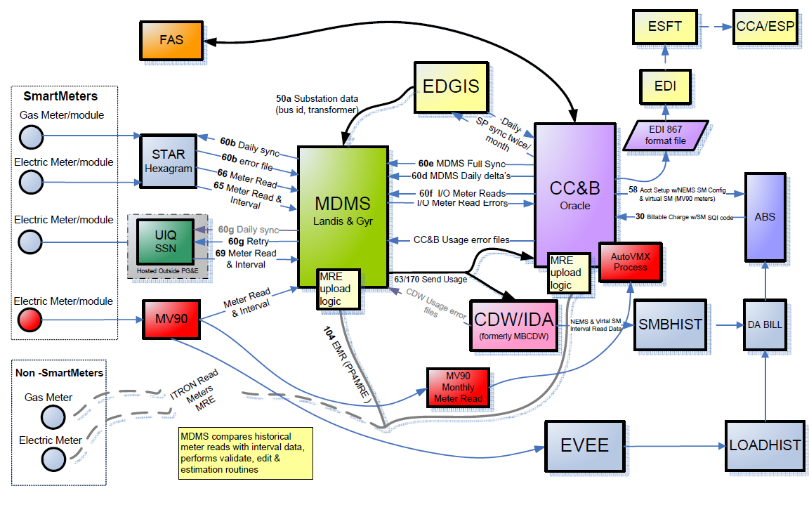
Billing Systems Overview
2

Slide 3
Key Customer Billing System Overview
System | Description
Customer Care & Billing (CC&B) | CC&B is a mission critical system that supports nearly all PG&E gas and electric customers territory-wide, producing 250,000 bills and processing over $60 million in payments daily. Further, CC&B supports emergency field response, contact centers, customer web, etc. Deployed in 2002, last upgraded in April 2017
Meter Data Management System (MDMS) | MDMS was deployed to support the collection of gas and electric usage data and uses an analytics Validation, Estimation, Editing (VEE) engine that processes millions of register and internal reads to develop billing quality data that is sent to the CC&B billing system. MDMS allows for Billing Operations to perform exception management and remediation of events related to the VEE process. Deployed in 2007, last upgraded in 2011
Aclara Hexagram | PG&E’s gas SmartMeter infrastructure is built on Aclara Hexagram Star application and network hardware designed to support up to 5 million gas meters across the PG&E service territory. The Aclara system is hosted and managed in PG&E data centers. Deployed in 2007, last upgraded in 2015
Silver Spring Networks (SSN) | PG&E's electric SmartMeter infrastructure is built on SSN's UtilityIQ (UIQ) application and network hardware that is designed to support up to 5.8 million electric SmartMeters, across PG&E's service territory. The SSN UIQ application and Automated Metering Infrastructure network is currently managed by SSN, and is hosted in two separate data centers in Las Vegas and San Diego. Deployed in 2008, last upgraded in 2015
3

Slide 4
Key System Overview
System | Description
EDI (Electronic Data Interchange) and Third Party Billing | The EDI process is used to transmit to and receive files from third-party Energy Service Providers. It was upgraded in 2012 to use Oracle B2B SOA technology. The platform was sized based on number of customers/trading partners at the time. The number of customers and transactions has increased dramatically since then as the adoption of Community Choice Aggregation (CCA) has increased. Platform was replaced in 2012, with new platform planned by EOY 2017
ESFT (Secure File Transfer) | Secure File Transfer enables the secure transfer of files both internally to PG&E and externally to third parties through various protocols. Application was last upgraded in 2014
4

Slide 5
System Sustainability
Age of System
PG&E’s original CIS was 35 years old when replaced in 2002
System was replaced because the rating engine could not support Direct Access
Vendor Support
PG&E decided to license a packaged solution in order to rely on a vendor to continuously maintain and improve the system
PG&E owns the system hardware and licenses for the vendor packages
The current CC&B implementation is an “off-the-shelf” product with approximately 12% customized code. The customizations are largely due to process automation, Direct Access/CCA, and Net Energy Metering
PG&E works closely with our vendor to ensure future product releases address functional changes
Upgrades
Rapid pace of change is a huge challenge – CIS upgrades are required every 5-7 years to stay up-to-date
Since installing CC&B 15 years ago, PG&E has completed 4 major upgrades
Most recent upgrade was to version 2.4 in April 2017. Work was also completed to have CC&B on a Tier 1 (four hour return to operation) Disaster Recovery platform.
Supporting Resources
The overall resource support mix is 60% employee and 40% contractor.
5

Slide 6
Challenges Posed by Our Systems
Billing
Incorrect data from upstream processes can lead to incorrect billing (e.g., GT&S therm factors, rate values).
Rate structures and related business processes are complex. This drives higher costs and lead times for system enhancements.
EDI and Third Party Billing – EDI is the technology used for PG&E to exchange information (usage and bill ready charges) with Third Parties (CCAs, ESPs and CTAs)
Throughout 2015, increase in daily volume of EDI transactions outpaced system ability to process transactions in a timely manner.
September 2016 to current, multiple incidents of ESFT connectivity issues. This interrupted file transactions flow with third parties.
Usage Processing – the primary purpose of the MDMS is to perform VEE (Validation, Editing, and Estimation) on interval usage.
The current MDMS platform will soon be unsupported, leading to increased security and business continuity risks.
Relies on batch synchronization of data between CC&B and MDMS. This can result in processing delays, error correction, and impacts to billing timeliness
6

Slide 7
EDI Upgrade to Support CCA Expansion
EDI Infrastructure and Software Upgrade planned to be completed by EOY 2017.
EDI upgrade will support the following improvements:
Ability to provide timely, accurate and reliable two-way EDI information for our CCA partners, customers and PG&E billing and payment departments for consumption
Ability to scale capacity and plan for the future growth of CCA customers
Improved and efficient operations with CCAs and their back office EDI providers
Faster and more accurate processing of files
Improved tracking and monitoring of individual transactions and statuses
Significant reduction and/or elimination of manual error correction processes
Standardized and optimized process for managing interfaces
Updated and consolidated documentation of EDI interface specification
PG&E will Informatica Data Exchange, a licensed vendor package for this solution.
7

Slide 8
MDMS Upgrade
Meter Data Management System (MDMS) is a PG&E-hosted system using licensed vendor package that collects daily meter data for approximately 4.5 million gas customers and 5.2 million electric customers. The Landis+Gyr (L+G) MDMS application will soon be an unsupported platform with cybersecurity and business continuity risks. PG&E is planning to upgrade the L&G MDMD by October 2018.
Reasons to upgrade
Risk of sustained billing outage - Without this L+G MDMS software upgrade, there is an increased risk of billing delays caused by a sustained MDM system outage.
Risk of downstream operational failures - There is a risk of data delivery delays to downstream systems, which will become a significant risk when 3 million residential customer’s bills are calculated using interval data.
Compliance - Ensure that PG&E’s billing systems are ready to support the upcoming default time-of-use rates.
8

Slide 9
Time-of-Use Implementation
Residential Default Time Of Use (TOU) in 2019
Transition ~2.6 million residential customers to interval billing to support TOU rates
10 months to complete interval billing transition
Transition ~65k customers per week for 10 consecutive months
Weekly volume limited due to system limitations and resources required for transition errors
Forecasted auto transition error rate of 1% (~2,600 monthly)
Increased interval billing exception rate
Rate Reform Initiative | Volumes | Jan 2018 | Feb 2018 | Mar 2018 | Apr 2018 | May 2018 | Jun 2018 | July 2018 | Aug 2018 | Sept 2018 | Oct 2018 | Nov 2018 | Dec 2018 | Jan 2019 | Feb 2019
Full TOU Default - Transition | 2,600,000 |  |  | 260k | 260k | 260k | 260k | 260k | 260k | 260k | 260k | 260k | 260k
Full TOU Default - Exceptions | 26,000 |  |  | 26,000 Forecasted Workflow Errors
9

Slide 10
PG&E’s Ability to Deliver Residential Default TOU
With the deployment of SmartMeters in 2007 and the successful implementation of many demand response and marketing programs, PG&E has demonstrated that it can deliver large and complex initiatives to support the upcoming Default TOU. For example:
Customer Eligibility – Common capability used for many programs such as SmartRate, Peak Day Pricing (PDP), PG&E Solar Choice, High Usage Energy Surcharge, etc.
New TOU Rates – In 2016 new rate schedules were built in both CC&B and the Advanced Billing System. These changes were built on time and on budget
Automated Bill Protection – Previously built for SmartRate and Peak Day Pricing Rates. Will be developed for the TOU default rate
Rates Analysis & Tools – Leverage existing capabilities of OPOWER and GRID X currently used for rate analysis and rate mailer
Customer Communications – Customer letters are triggered from workflow capabilities, such as TOU transition
Default/Opt out Process – Built for Default TOU and PDP Rates. Will be enhanced for new TOU rates
10

Slide 11
Appendix
11

Slide 12
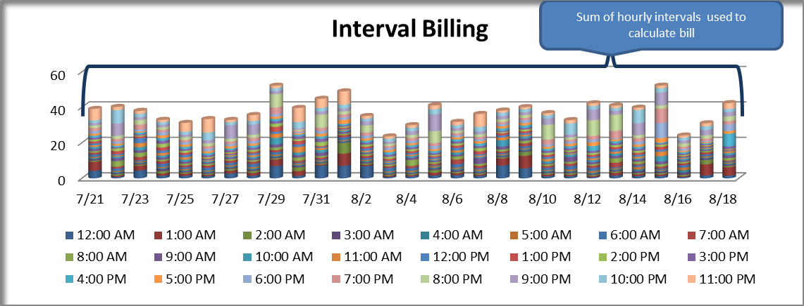
SmartMeter Anchor vs Interval Billing
ANCHOR billing - 2 pieces of data per month
INTERVAL billing - 720 pieces of data per month
12

Slide 13
Upcoming Rate Change Cases
Forecasted Impacts
Estimated based on volumes from 2016 Rate Mailer Test & Learn
2017
TOU Acquisition – June
Rate Mailer – Oct/Nov
2018
820 rate change cases
5,200 rate change cases
5,200 rate change cases
Rate Mailer – Sept/Oct
5,200 rate change cases
Rate Mailer – April/May
Rate Reform Initiative | Volumes | Jun 2017 | July 2017 | Aug 2017 | Sept 2017 | Oct 2017 | Nov 2017 | Dec 2017 | Jan 2018 | Feb 2018 | Mar 2018 | Apr 2018 | May 2018 | Jun 2018 | July 2018 | Aug 2018 | Sept 2018 | Oct 2018 | Nov 2018 | Dec 2018
TOU Acquisition | 200,000 | ~820 cases
Rate Mailer | 2,600,000 |  |  |  |  | ~5,200 cases |  |  |  |  |  | ~5,200 cases |  |  |  |  | ~5,200 cases
13

