Slide 1
CA COVID-19 Rent Relief Program
Utility Provider Listening Session
March 11, 2021

Slide 2
Legislative Background

Slide 3
Implementation Options
OPTION A
State-Administered Program
Jurisdictions that did not receive a federal allocation will have their funds administered by the state program.
Jurisdiction that did receive a federal allocation may opt into the state-run program.
OPTION B
Locally Administered Program
Jurisdictions that received a direct federal allocation agree to follow the SB 91 state program parameters and administer their state reservation as a block grant.
OPTION C
Dual Program
Jurisdictions with direct federal allocation opt not to follow SB 91 program parameters.
State administers jurisdiction’s state reservation.

Slide 4
OPTION A
All counties under 200 K population and the cities within them
Jurisdictions that opted into state-run program:
City of Fontana
City of Oxnard
Butte County
Contra Costa County
Los Angeles County
San Luis Obispo County
San Mateo County
Santa Cruz County
Tulare County
Ventura County
Yolo County
OPTION B
City of Anaheim
City of Bakersfield
City of Chula Vista
City of Fremont
City of Fresno
City of Irvine
City of Long Beach
City of Los Angeles
City of Modesto
City of Sacramento
City of San Diego
City of Stockton
Alameda County
Fresno County
Kern County
Marin County
Monterey County
Sacramento County
San Diego County
San Joaquin County
Sonoma County
Stanislaus County
OPTION C
City of Moreno Valley
City of Oakland
City of Riverside
City of San Bernardino
City of San Jose
City of Santa Ana
City of Santa Clarita
Merced County
Orange County
Placer County
Riverside County
Santa Barbara County
Santa Clara County
San Francisco City & County
Solano County
Current as of 2/21/21

Slide 5
State Program Overview

Slide 6

Program Overview
Focus: Stabilize low-income households through the payment of rental and utility arrears to landlords and providers
Eligibility:
  Income must be below 80% Area Median Income (AMI) based on total household income for calendar year 2020 or the household’s monthly income at the time of application.
  Household must have a COVID-19 impact.

Slide 7



Program Overview
Participating utilities will be compensated 100% of unpaid utility arrears from April 1, 2020 - March 31, 2021.
If a landlord declines to participate, eligible households can still apply for and receive 25% of back rent owed for the covered period, however utilities are still at 100%.
Utilities paid as part of the unit’s rent are managed by the landlord and not eligible for separate utility assistance.
Rental and utility arrears will be prioritized over current and prospective rental and utility payments.

Slide 8

Partner Network
Nonprofit and community partners with capacity to provide local on the ground and in-language support to residents.
Three-tiered strategy:
  Promotion of the program
  Targeted outreach to eligible households
  Technical assistance to provide guidance to individuals as they navigate the application process

Slide 9

Outreach & Education
People centered and culturally sensitive messaging.
Outreach campaign includes:
  Message development
  Paid and earned media
  Social media
  Digital buy
  Partnership development to supplement local partner network
Develop local partner network toolkit and materials for jurisdictions.

Slide 10
Program Operations
Centralized online portal with options for tenants and landlords to apply
Multiple languages, accessibility assistance, live-person tutorials, and in-person support through the partner network
Case management for applications that need assistance to reach completion
Transparent eligibility screening with additional resources
Portal routes applicants to appropriate jurisdictions for Options B and C
Portal provides guidance to help applicants prepare necessary documents
    Application designed to collect the minimum information necessary to meet state and federal standards while also addressing de-duplication and fraud prevention
    Application facilitates landlord engagement in tenant submitted applications
    Application allows multiple options for utility assistance
    Utility assistance requests must be verified with the Utility provider and are paid directly to the provider.

Slide 11
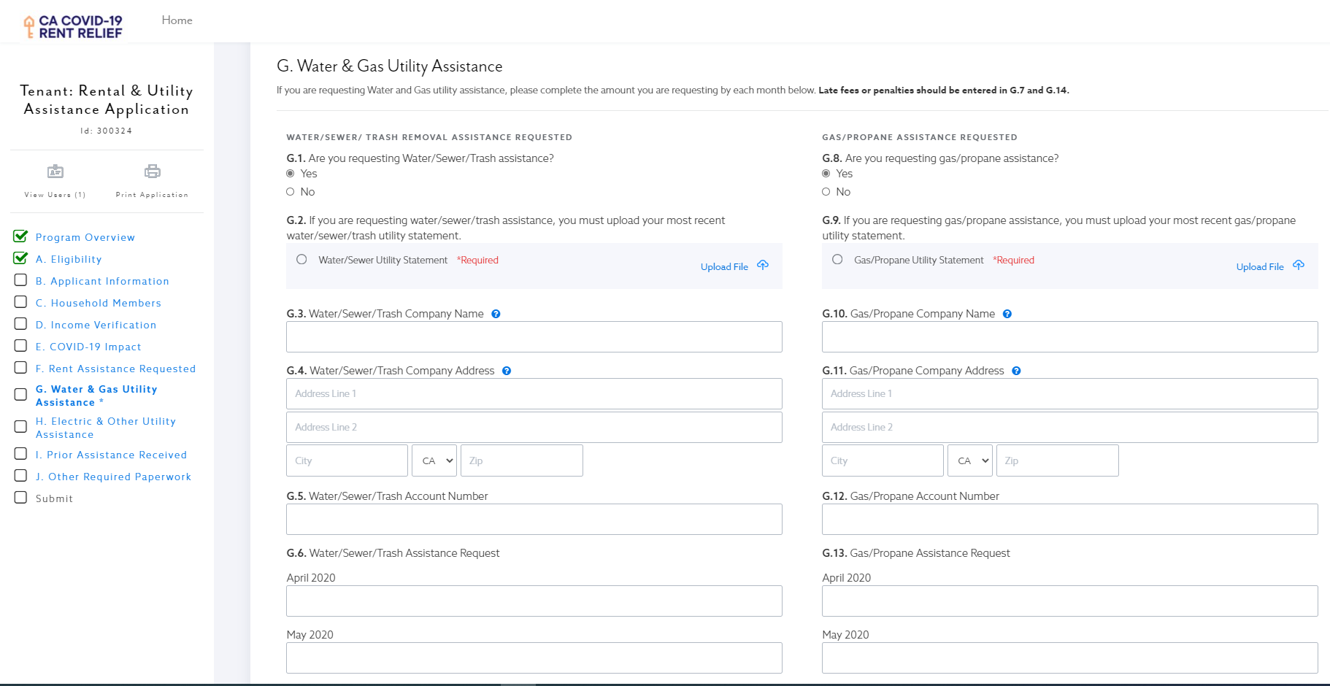
Utility Assistance Application Water and Gas

Slide 12
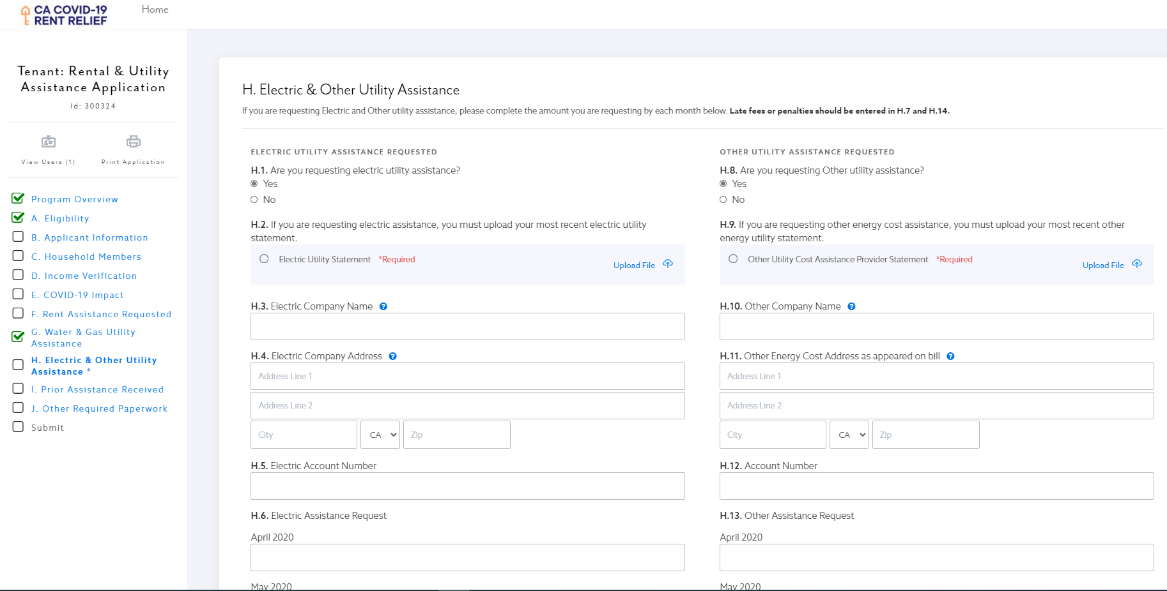
Utility Assistance Application Electricity

Slide 13
Application Steps
Tenant Application
Complete applications routed to Landlord for key data confirmation
Landlord and Utility Verification
Option for tenants whose landlords elect to not participate – tenant receives payment
Application Review
Requests for additional documentation if necessary
Approved Application
Routed for payment via direct deposit or paper check
Notification of payment with program participation details sent to both landlord and tenant, and utility provider if applicable
Participating landlords will receive direct payment
Participating utilities will receive direct payment
Case management will make multiple attempts to get applications complete

Slide 14
Opportunities for Utility Engagement
Help get the word out to potential applicants
  Inserts, emails, customer communications
Encourage enrollment in low-income support programs
  CARE, FERA, ESA, https://www.cpuc.ca.gov/iqap/
Establish protocols for inquiries from Rent Relief Program Case Managers looking to validate applicant information
Continue to engage with HCD and local partners to help identify gaps and bottlenecks in the program
Notes:
California Alternate Rates for Energy (CARE) - Provides a 30-35%¹ discount on your electric bill and 20% on your gas bill.
The Family Electric Rate Assistance Program (FERA) - Bills some of your electricity usage at a lower rate.
Energy Savings Assistance Program - Provides no-cost weatherization services.
Discounts, Payment Plans, and Assistance Paying Your Bill - Some utilities offer payment assistance programs for their customers.
Medical Baseline - Extra allowances of energy are billed at the lowest rate for customers who rely on medical-related equipment.
Federal Low-Income Programs - Administered by the Department of Community Services and Development (CSD).

Slide 15

Questions / Comments?
Questions
ERAP@hcd.ca.gov
Landlord / Tenant / SB 91 Information
Housingiskey.com

