Slide 1
CPUC Environmental & Social Justice Action Plan
Draft Version 2.0
Disadvantaged Communities Advisory Group (DACAG)
Friday October 15, 2021

Slide 2

About the ESJ Action Plan
Operating framework with which to integrate ESJ considerations throughout the agency’s work.
Version 1.0 was adopted in February 2019.
Consists of:
  9 overarching goals
  Clear objectives
  95 concrete action items (Draft 1.0) to ensure agency-wide collaboration, accountability, and forward movement in meeting ESJ principles.
Notes:
Image Source: https://www.healthandenvironment.org/environmental-health/social-context/history/environmental-justice-or-rather-injustice
ESJ Action Plan Goals:
Consistently integrate equity and access considerations throughout CPUC proceedings and other efforts.
Increase investment in clean energy resources to benefit ESJ communities, especially to improve local air quality and public health.
Strive to improve access to high-quality water, communications, and transportation services for ESJ communities.
Increase climate resiliency in ESJ communities.
Enhance outreach and public participation opportunities for ESJ communities to meaningfully participate in the CPUC's decision-making process and benefit from CPUC programs.
Enhance enforcement to ensure safety and consumer protection for ESJ communities.
Promote economic and workforce development opportunities in ESJ communities.
Improve training and staff development related to ESJ issues within the CPUC's jurisdiction.
Monitor the CPUC's ESJ efforts to evaluate how they are achieving their objectives.
Core Team & ESJ Liaisons
Represent each Division at the CPUC and tasked with tracking status of action items and serving as “ambassador” in Division for ESJ issues

Slide 3
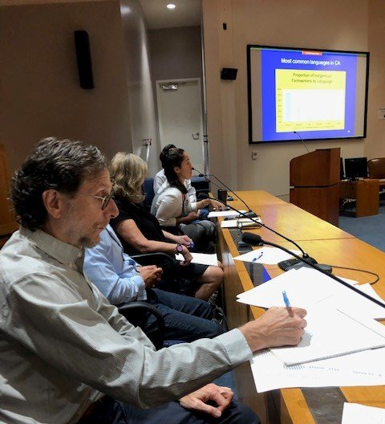
Update Process
February 2021 workshop to collect feedback from stakeholders through moderated discussions and issue specific breakout rooms.
Additional feedback from a number of proceedings and ongoing engagement with stakeholders.

Slide 4
Overview of Changes in Version 2.0
All Action Items and Objectives have been updated to reflect present-day priorities and efforts.
Updated Goal 7 (Workforce Development): “Foster high road employment opportunities and career paths for residents of ESJ communities.”
Equitable distribution of Action Items across all CPUC Industry Divisions.
Appendices include resource documents to assist CPUC staff and stakeholders in incorporating ESJ issues into their work. These include:
  Examples of ESJ in proceedings and programs;
  A guide of definitions and terminology related to ESJ concepts; and
  Key documents for use in implementing the ESJ Action Plan.

Slide 5
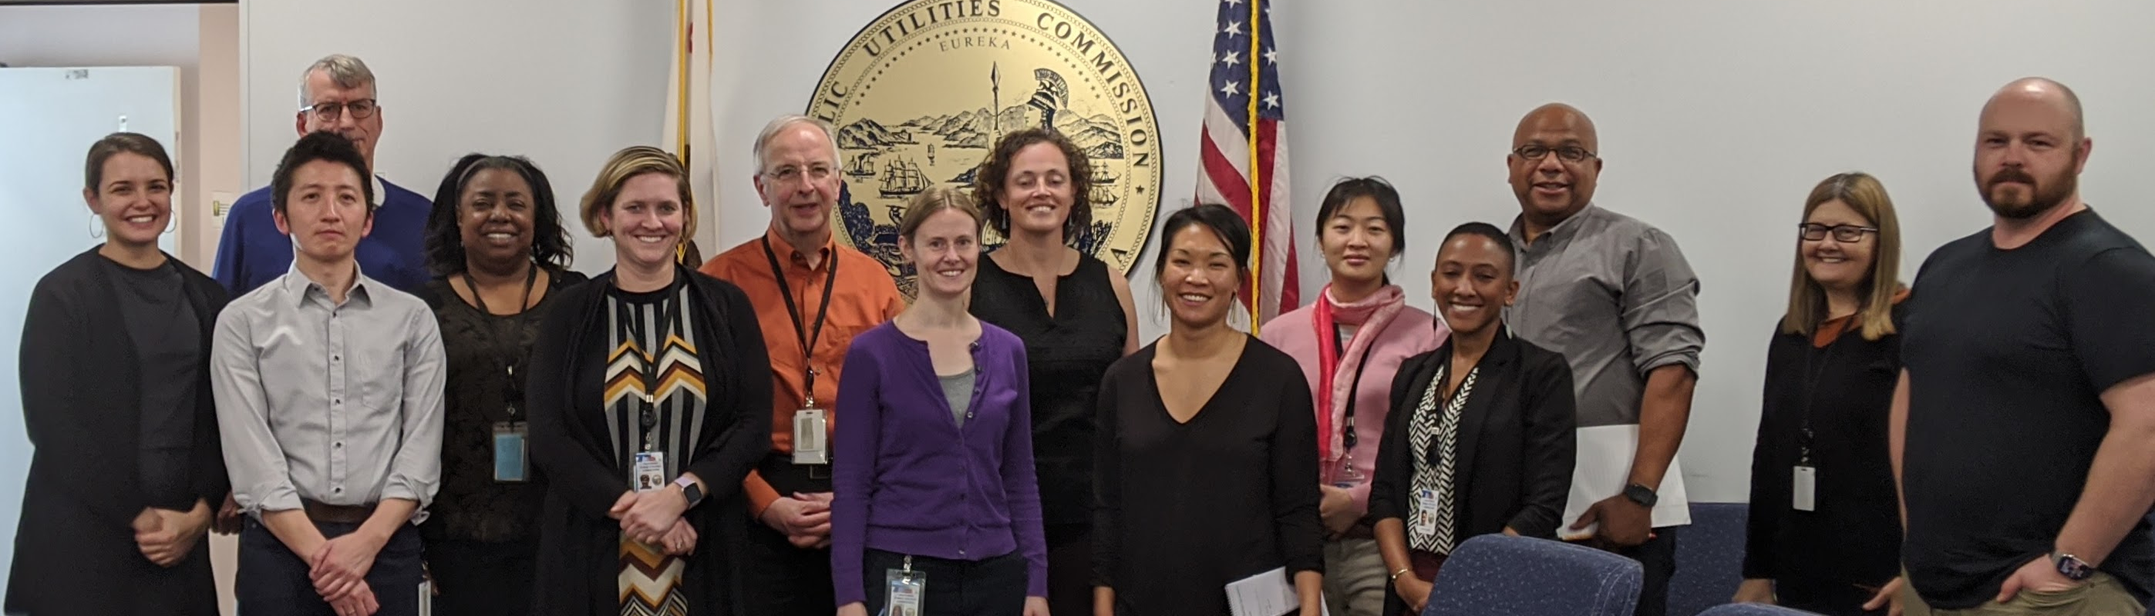
Action Items: Equity & Alignment
1.1.1 ESJ Impacts in CPUC Processes
8.1.1 Division-Specific Training on Incorporating ESJ Issues into Proceedings
1.1.5 ESJ Definitions: Catalogue and Assess Opportunities for Mutual Eligibility
2.1.1 Alignment & Coordination Across Marketing, Education & Outreach (ME&O) Plans
8.2.1 Alignment with Upcoming Racial Equity Action Plan
Notes:
1.1.1 ESJ Impacts in CPUC Processes: Continue to systematically incorporate ESJ considerations into proceedings, and further pursue opportunities to incorporate ESJ into Advice Letters, Resolutions, and other processes. [Emphasize scoping phase]
8.1.1 Division-Specific Training on Incorporating ESJ Issues into Proceedings: Work within each CPUC division to provide tailored trainings for staff on how to incorporate ESJ issues into CPUC processes.
1.1.5 ESJ Definitions: Catalogue and Assess Opportunities for Mutual Eligibility: Catalogue definitions being used across the CPUC for ESJ purposes and create a framework for the creation of future definitions. Consider opportunities for alignment and mutual eligibility in coordination with industry divisions
2.1.1 Alignment & Coordination Across Marketing, Education & Outreach (ME&O) Plans: Leverage ongoing work across a multitude of investor owned utilities (IOU) initiatives and programs to create synergy and deepen impact in ESJ communities, especially related to partnerships with community-based organizations (CBOs).
8.2.1 Alignment with Upcoming Racial Equity Action Plan: Support CCORE cohort to implement forthcoming CPUC Racial Equity Plan and support any efforts to conduct training for staff on racial equity issues.

Slide 6
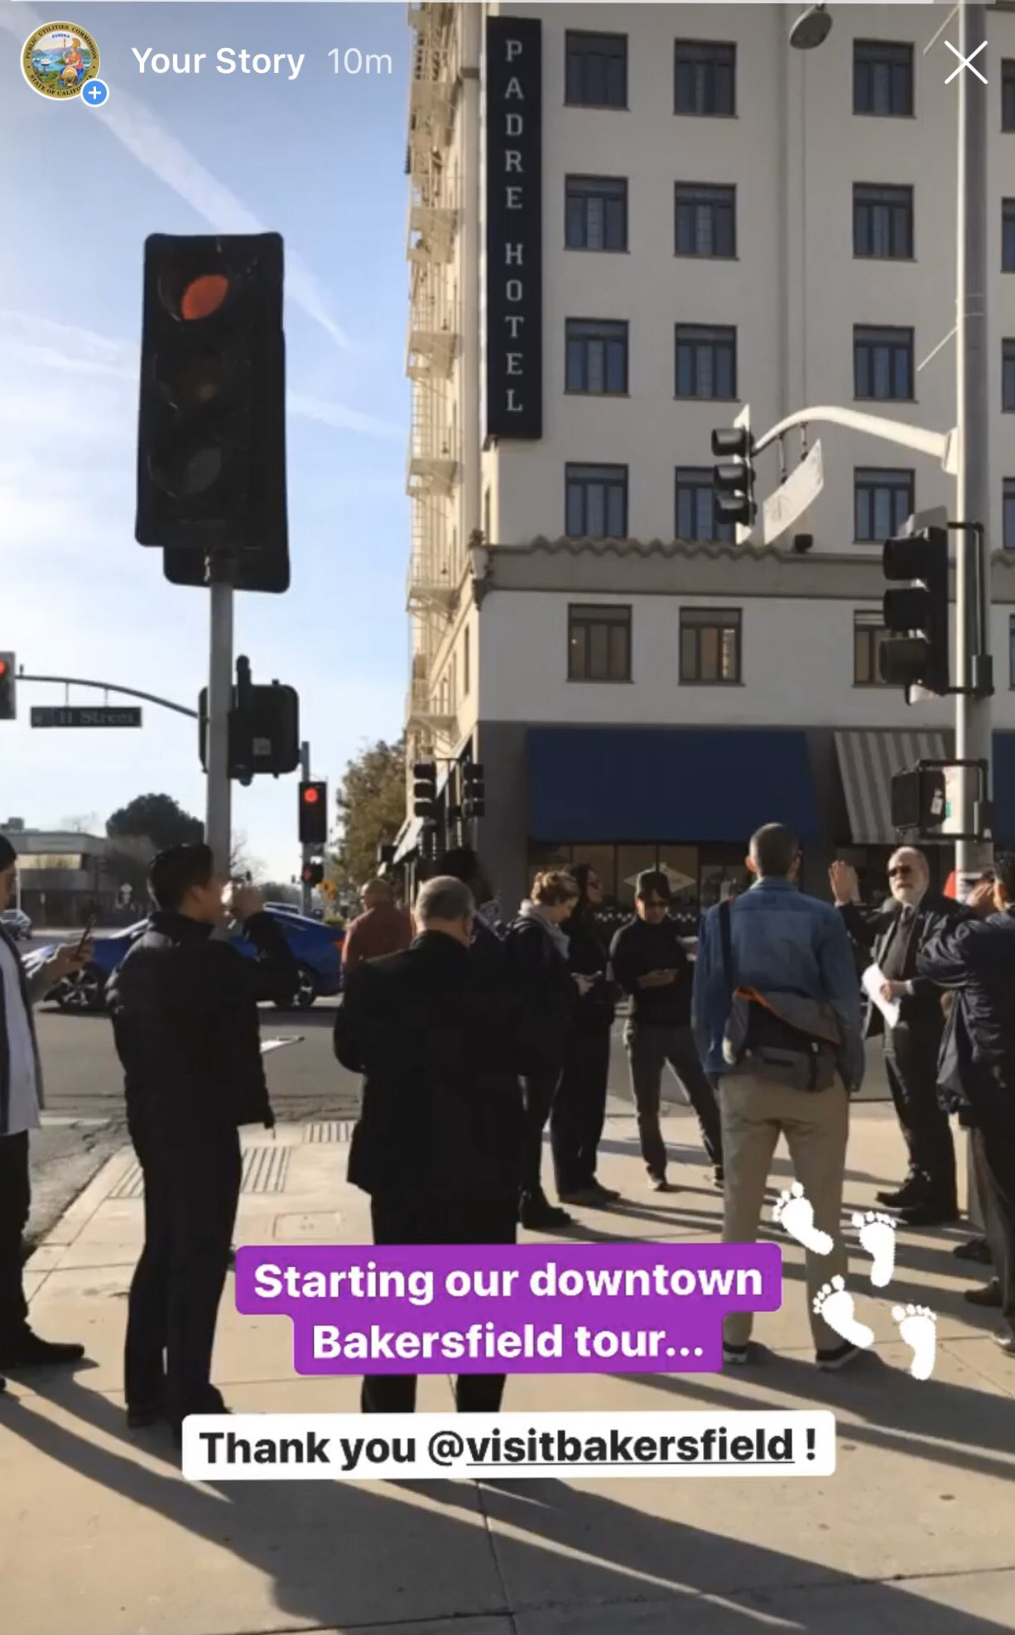
Action Items: Community-Based Organizations
1.2.1 Evaluation of Intervenor Compensation Program
1.2.2 Pilot Program for Participation of Community Based Organizations
1.2.5 Host Regular "Participate in CPUC" Sessions
5.2.2 Leverage CBOs for CPUC Workshops and Community Engagement
Notes:
1.2.1 Evaluation of Intervenor Compensation Program (ICOMP): Conduct an assessment of the current ICOMP successes and challenges, and propose recommendations for future improvements, both administrative and statutory.
1.2.2 Research Feasibility of a Pilot Program for Participation of Community Based Organizations (CBOs): Identify a funding source outside of ICOMP and create a pilot program that aims to facilitate deeper involvement of CBOs in CPUC programs and processes.
1.2.5 Host Regular "Participate in CPUC" Sessions : Host virtual workshops on "Participating in CPUC Processes" to provide education on proceedings, processes, programs, how to engage, etc.
5.2.2: Leverage CBOs for CPUC Workshops and Community Engagement: Consider how CBOs can provide critical services and assistance to CPUC staff in the planning, outreach, and facilitation of proceeding-related workshops and other engagement needs. Pursue opportunities to provide grants or contracts with CBOs with relevant experience.

Slide 7
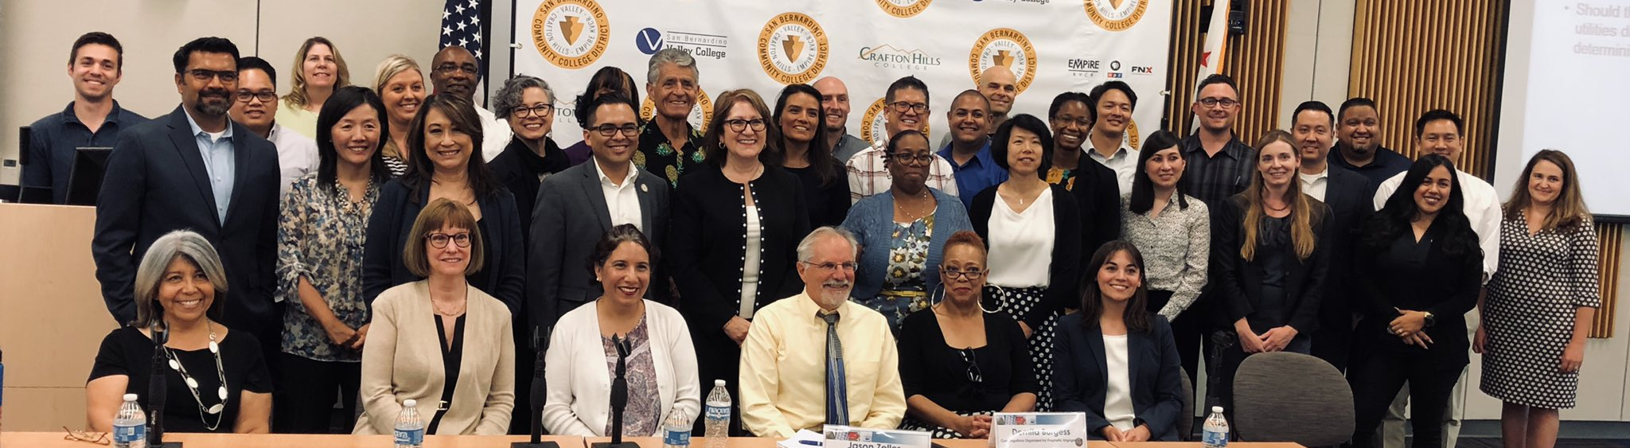
Action Items: Enforcement
6.2.3 Expand Opportunities to Leverage Enforcement Action Settlements for ESJ Purposes
6.3.1 Develop an ESJ Lens for New CPUC Enforcement Policy
Notes:
6.2.3 Expand Opportunities to Leverage Enforcement Action Settlements for ESJ Purposes: Building on long-running practice of supporting low-income and ESJ-related programs, consider ESJ communities when considering alternative enforcement options, or when considering recipients of settlement funds after restitution and fines.
6.3.1 Develop an ESJ Lens for New CPUC Enforcement Policy: Based on lessons learned from sister agencies, develop a training on ESJ issues and guidance on how to approach enforcement from an ESJ perspective. Consider pilot opportunities.

Slide 8
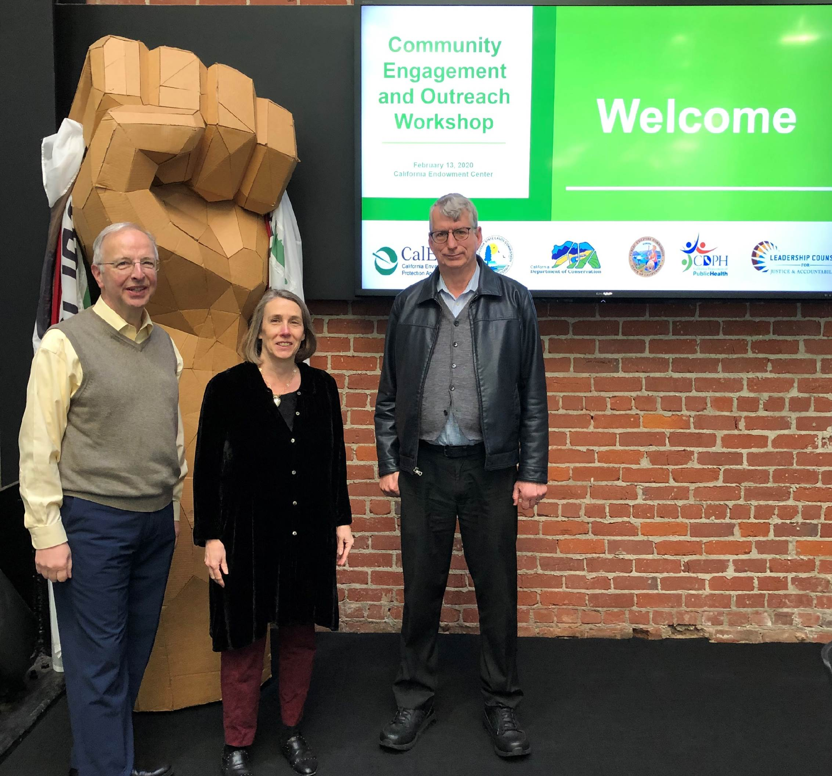
Action Items: Training & Metrics
8.1.2 ESJ Session at New Employee Orientation (NEO)
8.2.2 Community Engagement Training for CPUC Staff
8.2.4 Meeting Facilitation Training for Staff
9.1.1 Metrics to Measure Impact, Community Outreach & Engagement
9.2.1 Metrics to Measure Satisfaction, Comprehension, and Experience
Notes:
9.1.1 Metrics to Measure Impact, Community Outreach & Engagement: Develop metrics, criteria, and guidance to ensure that utility programs and/or funds are having the intended effect, and measure meaningful and effective outreach and engagement.
9.2.1 Metrics to Measure Satisfaction, Comprehension, and Experience: Identify qualitative information-gathering strategies of utilities and evaluative spectra to help measure issues such as comprehension, satisfaction, and effectiveness of utility marketing, education, and outreach. Ensure there are pathways to act on information received.

Slide 9
Tracking & Accountability
Action Items have a 3-year time horizon
  Tentatively 2022-2025
Mid-Point Status Report, offering latest information on implementation of all 91 Action Items, to be published in 2023
  ESJ Liaisons will provide key support in drafting Status Report
  Include public presentation to Commissioners and DACAG

Slide 10
Tentative Timeline & Next Steps
Presentation to Low Income Oversight Board (LIOB) | Wednesday September 29
Presentation to Disadvantaged Communities Advisory Group (DACAG) | Friday October 15
Post Draft Version 2.0 for Public Comment | Wednesday October 20
Business & Community Outreach (BCO) Webinar Register Here | Wednesday November 3 10:00 – 11:45 AM
Public Comment Deadline | Friday November 19
Post Final Version | TBD
Commissioner Voting Meeting for Adoption | TBD

Slide 11
Comment Letters
Full Draft ESJ Action Plan available at: www.cpuc.ca.gov/ESJActionPlan
Comments Due:
Friday November 19, 2021
Submit Comments to:
ESJActionPlan@cpuc.ca.gov

Slide 12
THANK YOU!
Monica Palmeira | News & Outreach Office Monica.Palmeira@cpuc.ca.gov
Nicole Cropper | Office of the Commission
Nicole.Cropper@cpuc.ca.gov
Sarah Sharpe | Office of Commissioner Guzman Aceves
Sarah.Sharpe@cpuc.ca.gov

