Slide 1
California LifeLine Third Party Administrator
Presentation to the Administrative Committee
June 20, 2023

Slide 2
Renewal Process Resumption – Statistics and Progress
California Public Utilities Code § 878.6 (b) provides:
  Before January 1, 2023, the commission shall, as part of an existing proceeding and in consultation with lifeline service providers, the Federal Communications Commission, and the Universal Service Administrative Company, adopt updated rules for the lifeline program with the goal of achieving recertification rates at least equivalent to those rates achieved by the Universal Services Administrative Company as the administrator for the federal lifeline program.
USAC has shared its renewal calculation method:
  USAC determines the renewal rate by taking the total population eligible for renewal vs. those who fail to pass the renewal. (total failed renewal/total eligible to renew) This will include consumers who pass the renewal process using automatic database checks.

Slide 3
Renewal Process Resumption – Statistics and Progress
Lifeline National Verifier (Verifier) Reverification and Recertification Outcomes by Availability of State Database Connections
Between June 2018 and June 2020, existing Lifeline subscribers in states with state database connections to the Verifier were more likely to have their continued eligibility for Lifeline confirmed during reverification and recertification than those in states without any such connections. On average:
• About 75 percent of existing subscribers in states with state database connections to the Verifier were reverified, while just 59 percent of existing subscribers were reverified in states without such connections.
• Nearly 90 percent of existing subscribers were recertified in states with state database connections to the Verifier, while just 73 percent of existing subscribers were recertified in states without such connections.
Source: GAO analysis of Federal Communications Commission data. | GAO-21-235

Slide 4
Renewal Process Resumption – Statistics and Progress
Catchup Period (Renewals starting 7/1/2022 – 10/31/2022)
• Eligible for renewal – 591,115 + 353,557 (preemptive renewal population)
• Failed renewal
  Hard denied/initial form – 7,672
  Hard denied / second form – 196,866
Total population who fail to pass the renewal / Total population eligible for renewal = Renewal Failure Rate
204,538 / 944,672 = 21.65%, thus the renewal rate for the Catchup Period is 78.35%

Slide 5
Renewal Process Resumption – Statistics and Progress
Post-Catchup Period (Renewals starting 11/1/2022 – 3/3/2023)
• Eligible for renewal – 330,223
• Failed renewal
  Hard denied/initial form – 3,813
  Hard denied / second form – 59,202
Total population who fail to pass the renewal / Total population eligible for renewal = Renewal Failure Rate
63,015 / 330,223 = 19.08%, thus the renewal rate for the Post-catchup Period is 80.92%

Slide 6
CalFresh Confirm Hub Impact - Renewals
Between 11/1/2022 and 3/3/2023 renewal processes started for 330,223 subscribers. We do not have results for all these subscribers yet because some are still within their 105-day renewal timelines
199,257 subscribers were found in CalFresh Confirm on day 0 and were renewed
838 subscribers were found in CalFresh Confirm by the reviewer during the review of their initial renewal forms and were renewed
5,114 subscribers were found in CalFresh Confirm before issuing a soft denial for nonresponse to the initial renewal form and were renewed
95 subscribers were found in CalFresh Confirm by the reviewer during the review of their second chance renewal forms and were renewed
4,341 subscribers were found in CalFresh Confirm before issuing a final hard denial for nonresponse to the initial renewal form and were renewed
209,645 subscribers were renewed based on CalFresh Confirm matches
As of 6/11/2023, for this population of subscribers, 242,478 subscribers have been successfully renewed
86.46% of the subscribers who have successfully renewed have renewed based on positive CalFresh Confirm matches

Slide 7
Outreach Partnership with California Dept of Social Services
Starting August 2022, DSS CalFresh added a hyperlink to CaliforniaLifeLine.com in its Additional Resources section
Through May 2023, there have been 4,571 unique click-throughs to the LifeLine public website
Month | Users referred from www.cdss.ca.gov to CaliforniaLifeLine.com
Aug 2022 | 770
Sep 2022 | 269
Oct 2022 | 371
Nov 2022 | 444
Dec 2022 | 349
Jan 2023 | 509
Feb 2023 | 491
Mar 2023 | 530
Apr 2023 | 420
May 2023 | 418

Slide 8
New TPA Contract Deliverables - Standalone Household Worksheet Process
Household worksheets are no longer be a part of the annual renewal form packets
Subscribers’ mid-term service address changes are evaluated for household worksheets
If a subscriber’s new service address matches the service address of an existing active subscriber, the subscriber whose address has changed must complete a household worksheet
Subscribers have thirty (30) calendar days to submit completed worksheets
Subscribers may submit completed worksheets to the TPA by mail, through CaliforniaLifeLine.com, through the TPA’s interactive voice response system, and through a Service Provider which uses the Service Provider Intake API (SPIA)
Benefits:
The LifeLine Administrator is better able to monitor compliance with the “one benefit per economic household” Program rule
Aligns to USAC’s household worksheet approach
More subscribers will be submitted on day 0 for CalFresh Confirm database matching

Slide 9
New TPA Contract Deliverables - Standalone Household Worksheet Process – Data for 3/31/2023 – 6/5/2023
Issuance Month | Status | Count
March 2023 | Approved | 204
March 2023 | Cancelled | 17
March 2023 | Denied | 54

Slide 10
New TPA Contract Deliverables - Standalone Household Worksheet Process – Data for 3/31/2023 – 6/5/2023
Issuance Month | Status | Count
April 2023 | Approved | 6,909
April 2023 | Cancelled | 1,358
April 2023 | Denied | 4,257
April 2023 | Pending Response | 996

Slide 11
New TPA Contract Deliverables - Standalone Household Worksheet Process – Data for 3/31/2023 – 6/5/2023
Issuance Month | Status | Count
May 2023 | Approved | 6,751
May 2023 | Cancelled | 566
May 2023 | Denied | 206
May 2023 | Pending Response | 3,815
May 2023 | Pending Review | 30

Slide 12
New TPA Contract Deliverables - Standalone Household Worksheet Process – Data for 3/31/2023 – 6/5/2023
Issuance Month | Status | Count
June 2023 | Approved | 1,081
June 2023 | Cancelled | 53
June 2023 | Denied | 1
June 2023 | Pending Response | 950
June 2023 | Pending Review | 15

Slide 13
New TPA Contract Deliverables - Standalone Household Worksheet Process – Data for 3/31/2023 – 6/5/2023
Issuance Month | Total Denied | Denied – No Response | Percentage
March 2023 | 54 | 48 | 88.89%
April 2023 | 4,257 | 4,207 | 98.83%
May 2023 | 206 | 190 | 92.23%

Slide 14
New TPA Contract Deliverables – Expanded Reporting
Connection and Conversion Reports for Wireline Service Providers
Inward/Outward
Participant Emails
Webchat
Waste, Fraud, and Abuse Prevention
External Eligibility
Determination Invoice
Outage and TPA System Availability
Inbound Mail
Outbound Mail
Outbound Dialer
Inbound Calls
TPA Operations
Call Center Invoice
Daily Service Providers’ Requests and Error Activity
Public Website Analytics
National Change of Address
Enrollment, Caseload, and Population
Enrollment Statistics
Review Queue Snapshot

Slide 15
Program and Operations Reports
Program Participation – Active LifeLine Subscribers
Wireless: Response & Approval Rates – All Form Types
Wireline: Response & Approval Rates – All Form Types
Top 5 Denial Reasons
Subscriber Count Trends for Largest Service Providers
Enrollment Eligibility Methods – Program versus Income
Enrollment Eligibility Methods – By Qualifying Program
Enrollment Application Volume By Received Channel
Renewal Form Volume By Received Channel
Standalone IEH Volume By Received Channel
Call Volumes – English & Spanish
Call Volumes – Other Supported Languages

Slide 16
Program Participation – Active LifeLine Subscribers
  Current: Total Number of Active LifeLine Subscribers as of June 1, 2023
  Wireless: 944,708
  Wireline: 165,056
  Total: 1,109,764
  March 2023 Administrative Committee Meeting: Total Number of Enrolled Subscribers as of March 1, 2023
  Wireless: 954,950
  Wireline: 168,776
  Total: 1,123,726

Slide 17
Wireless: Response & Approval Rates – All Form Types
Month /Year | # Total | # Responded | % Responded | # Approved | % Approved
Jun 2022 | 137,389 | 122,977 | 89.5% | 118,779 | 96.6%
Jul 2022 | 125,364 | 113,846 | 90.8% | 110,915 | 97.4%
Aug 2022 | 191,822 | 174,339 | 90.9% | 171,147 | 98.2%
Sep 2022 | 211,606 | 188,609 | 89.1% | 181,954 | 96.5%
Oct 2022 | 264,663 | 202,030 | 76.3% | 187,793 | 93.0%
Nov 2022 | 256,948 | 190,492 | 74.1% | 177,724 | 93.3%
Dec 2022 | 233,616 | 178,431 | 76.4% | 167,259 | 93.7%
Jan 2023 | 190,784 | 165,495 | 86.7% | 159,026 | 96.1%
Feb 2023 | 163,260 | 138,778 | 85.0% | 132,669 | 95.6%
Mar 2023 | 165,362 | 140,428 | 84.9% | 133,838 | 95.3%
Apr 2023 | 153,505 | 135,357 | 88.2% | 130,855 | 96.7%
May 2023 | 152,288 | 140,806 | 92.5% | 137,491 | 97.6%
Total | 2,246,607 | 1,891,588 | 84.2% | 1,809,450 | 95.7%

Slide 18
Wireline: Response & Approval Rates – All Form Types
Month Year | # Total | # Responded | % Responded | # Approved | % Approved
Jun 2022 | 2,413 | 1,600 | 66.3% | 1,471 | 91.9%
Jul 2022 | 2,345 | 1,528 | 65.2% | 1,405 | 92.0%
Aug 2022 | 17,478 | 16,802 | 96.1% | 16,562 | 98.6%
Sep 2022 | 46,584 | 43,760 | 93.9% | 42,580 | 97.3%
Oct 2022 | 46,538 | 38,098 | 81.9% | 36,281 | 95.2%
Nov 2022 | 48,652 | 38,011 | 78.1% | 36,137 | 95.1%
Dec 2022 | 33,428 | 25,865 | 77.4% | 24,731 | 95.6%
Jan 2023 | 15,927 | 13,339 | 83.8% | 12,764 | 95.7%
Feb 2023 | 6,609 | 5,152 | 78.0% | 4,563 | 88.6%
Mar 2023 | 6,939 | 4,352 | 62.7% | 3,635 | 83.5%
Apr 2023 | 5,273 | 3,073 | 58.3% | 2,620 | 85.3%
2023 | 3,736 | 2,977 | 79.7% | 2,643 | 88.8%
Total | 235,922 | 194,557 | 82.5% | 185,392 | 95.3%

Slide 19
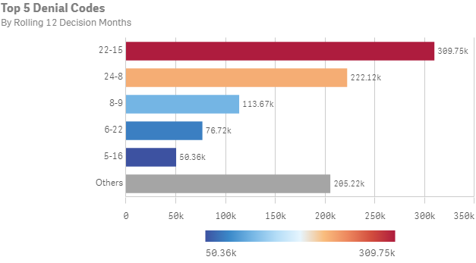
Top 5 Denial Reasons: June 2022 – May 2023
Denial Code | Type | Form | Description
22-15 | Correctible Denial | Renewal | Failure to return the renewal form by the due date
24-8 | Hard Denial | Renewal | Failure to return the renewal form by the due date
8-9 | Hard Denial | Application | Failure to return the application form by the due date
6-22 | Correctible Denial | Application | Documentation does not meet the eligibility guidelines.
5-16 | Hard Denial | Application | Failure to return ID verification form and documentation

Slide 20
Top 5 Service Providers by Subscriber Counts

Slide 21
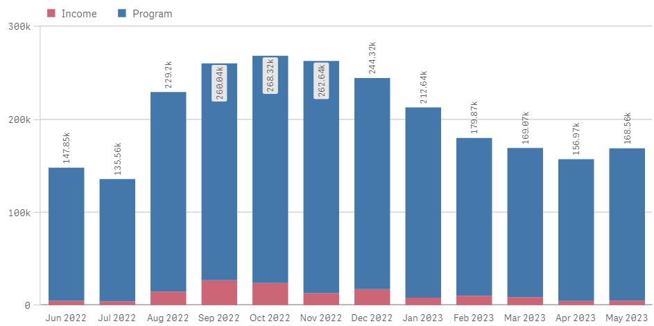
Enrollment Eligibility Methods – Program versus Income

Slide 22
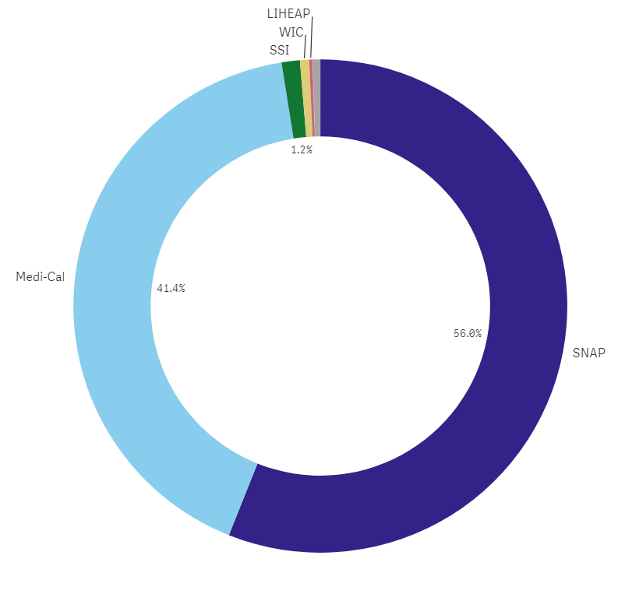
Enrollment Eligibility Methods – By Qualifying Program

Slide 23
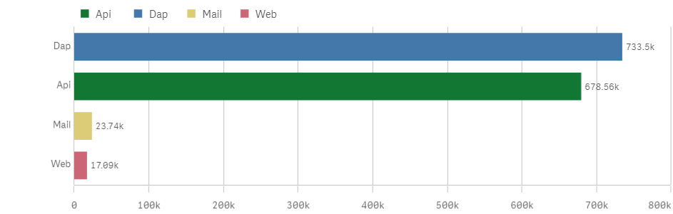
Enrollment Application Volume By Received Channel
June 2022 through May 2023
# Enrollment application forms received

Slide 24
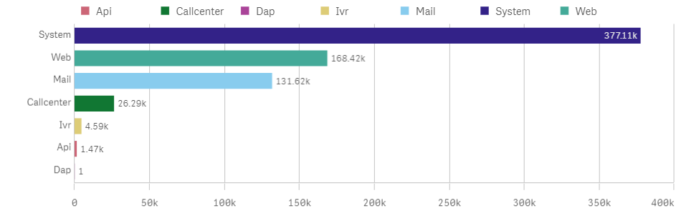
Renewal Form Volume By Received Channel
June 2022 – May 2023
# Renewal forms received

Slide 25
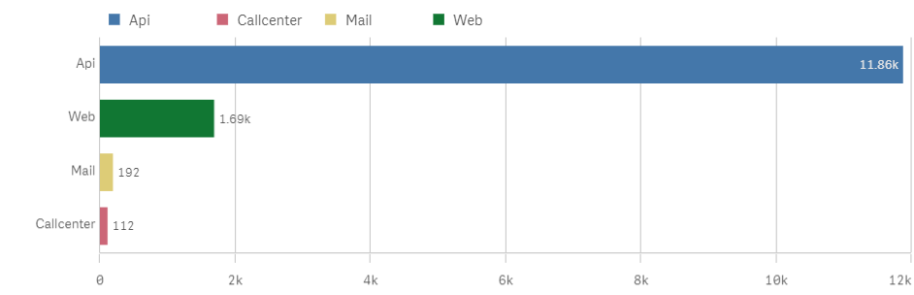
Standalone IEH Volume By Received Channel
June 2022 – May 2023
  # IEH forms received

Slide 26
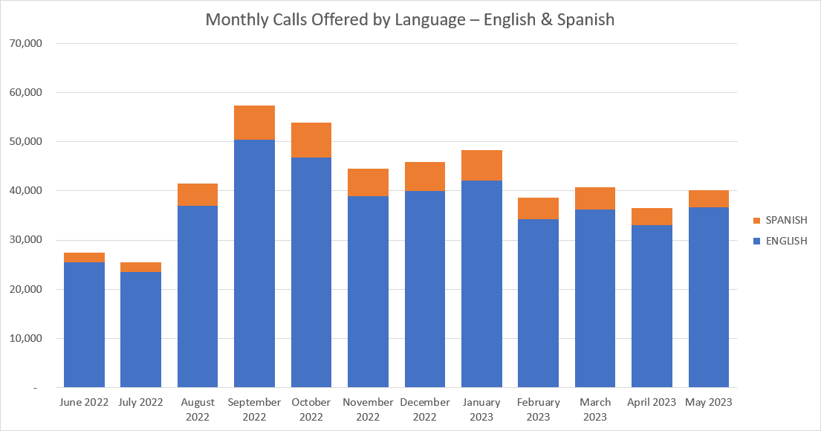
Monthly Inbound Call Volumes – English & Spanish
June 2022 through May 2023

Slide 27
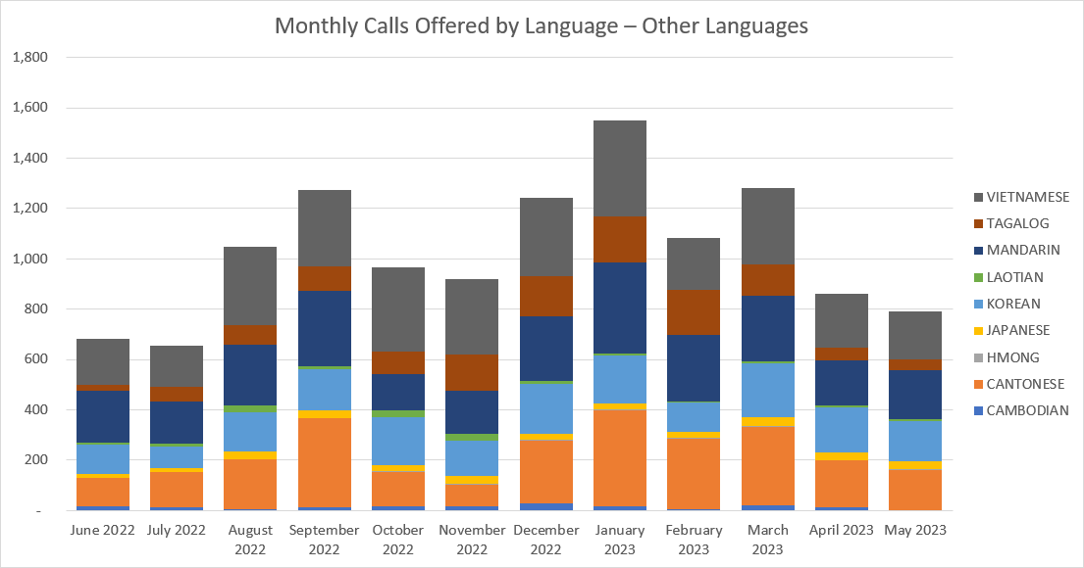
Monthly Inbound Call Volumes – Other Languages
June 2022 through May 2023

