Slide 1
California LifeLine Third Party Administrator
Presentation to the Administrative Committee
December 19, 2023

Slide 2
Completed Initiatives
Enhanced TPA’s “Customer Escalation” Process – September 12
Representatives from the TPA’s Call Center assist callers with completion of CPUC/CAB Inquiry forms using the CPUC’s public website (www.cpuc.ca.gov) to file complaints with the CPUC/CAB
The TPA’s Call Center has augmented this process to include alerting the TPA’s Management Team in the event a Service Provider should be contacted about an escalating caller’s issue
Common issues reported by consumers
Assistance starting the LifeLine enrollment process
Correcting SSN4 values and dates of birth
Correcting names and addresses
Obtaining LifeLine billing credits
As a result of this process change, from September 1 through December 12, the TPA’s Management Team has alerted Service Providers about 207 escalated consumer issues

Slide 3
Completed Initiatives
California LifeLine Customer Portal, Phase I – December 15
Commission-issued personal identification numbers (PINs) replaced with registered usernames and passwords
Registered users choose the multi-factor authentication (MFA) method: email, SMS text, or phone call
Online form completion and upload functionality offered by the public website remains the same but without the traditional PIN requirement
Registered users have the option to provide gender, race/ethnicity, and household income information
Registered users gain new self-help functionality:
Canceling pending transfers
Self-initiated removals from Program
Viewing font and language preferences
Viewing current address information stored with the TPA
Viewing Program anniversary dates (for renewal)
During the “soft launch” of the Customer Portal, from November 10th through December 13th, 10,674 portal users registered account profiles

Slide 4
Completed Initiatives
Collection of Additional Demographic Data from LifeLine Applicants and Subscribers
Annually, the CPUC must report to the California Legislature about the degree of achievement of universal telephone service for California residents, including Program penetration rates by income, ethnicity, and geography
The California LifeLine Customer Portal, Phase I, requests from portal users, during the registration process, voluntary responses to questions about
Total combined income of all members of portal users’ households
Portal users’ race/ethnicity
Portal users’ gender
Beginning December 15, 2023, collection of the additional demographic data has been introduced in new enrollment and renewal forms
The Service Provider Intake API, known as SPIA, has similarly been enhanced to collect the additional demographic data from applicants and subscribers

Slide 5
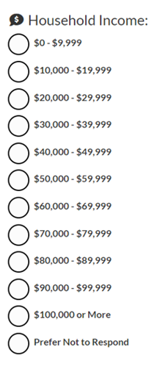
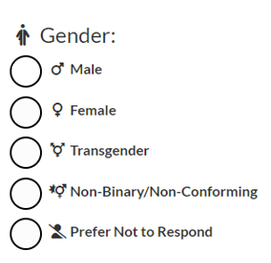
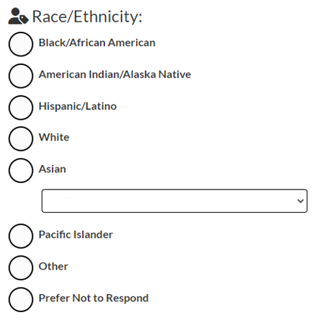
Completed Initiatives
Collection of Additional Demographic Data from LifeLine Applicants and Subscribers

Slide 6
Completed Initiatives
Collection of Additional Demographic Data from LifeLine Applicants and Subscribers
The “soft launch” of the California LifeLine Customer Portal offered the opportunity to track the engagement of portal users with the new demographic data questions
From November 10th through December 13th:
10,472 of the 10,674 registered portal users answered at least one of the new demographic questions during the registration process

Slide 7
Completed Initiatives
Co-branded Flyer with Anthem Blue Cross
The LifeLine Program collaborated with Anthem Blue Cross with the design of a flyer which provides a link and QR code to the LifeLine Customer Portal. This informational flyer helps interested consumers
Review the LifeLine Program’s eligibility guidelines
Search for a LifeLine service plan and Service Provider
Anthem Blue Cross is sharing the flyer with attendees of open enrollment member events throughout California
Since October 19, 2023, when Anthem Blue Cross started distributing the flyer, thirty-five (35) users have accessed the public website by utilizing the link provided in the flyer

Slide 8
Upcoming Initiatives
California LifeLine Customer Portal, Phase II
Targeted for February 2024
Enhancing the “My Account” Portal functionality to enable registered portal users to view and download Program decision letters
Implementing a “lookback” for the weekly USAC federal broadband-only subscribers lists
Targeted for February 2024
Augmenting Program waste, fraud, and abuse prevention measures

Slide 9
Program and Operations Reports
Program Participation – Active LifeLine Subscribers
Program Participation - Top 20 Counties
Wireless: Response & Approval Rates – All Form Types
Wireline: Response & Approval Rates – All Form Types
Top 5 Denial Reasons – New Enrollment Applications
Top 5 Denial Reasons – Renewal Forms
Subscriber Count Trends for Largest Service Providers
Top 5 Service Providers by Subscriber Counts
Enrollment Eligibility Methods – Program versus Income
Enrollment Eligibility Methods – By Qualifying Program
Enrollment Application Volumes By Received Channel
Renewal Form Volumes By Received Channel
Renewal Rate
Standalone IEH Volume By Received Channel
Call Volumes – English & Spanish
Call Volumes – Other Supported Languages

Slide 10
Program Participation – Active LifeLine Subscribers
Current: Total Number of Active LifeLine Subscribers as of December 1, 2023
Wireless: 1,000,314
Wireline: 150,821
Total: 1,151,135
September 2023 Administrative Committee Meeting: Total Number of Enrolled Subscribers as of September 1, 2023
Wireless: 952,257
Wireline: 160,590
Total: 1,112,847

Slide 11
Top 20 Counties By Active Subscribers’ LifeLine Service Addresses
LifeLine Service Address County | Total Active Subscribers
Los Angeles | 340,348
San Diego | 84,868
San Bernardino | 80,900
Orange | 72,838
Riverside | 71,404
Sacramento | 57,053
Fresno | 50,480
Kern | 44,704
Alameda | 34,101
San Francisco | 33,771
Santa Clara | 31,361
San Joaquin | 27,710
Stanislaus | 20,845
Contra Costa | 18,461
Tulare | 18,005
Ventura | 15,121
Imperial | 14,290
Merced | 12,994
Monterey | 11,441
Solano | 10,355

Slide 12
Wireless: Response & Approval Rates – All Form Types
Month Year | # Total | # Responded | % Responded | # Approved | % Approved | % Qualified or Renewed
Dec 2022 | 233,616 | 178,431 | 76.4% | 167,259 | 93.7% | 71.6%
Jan 2023 | 190,784 | 165,495 | 86.7% | 159,026 | 96.1% | 83.4%
Feb 2023 | 163,260 | 138,778 | 85.0% | 132,669 | 95.6% | 81.3%
Mar 2023 | 165,362 | 140,429 | 84.9% | 133,839 | 95.3% | 80.9%
Apr 2023 | 153,490 | 135,341 | 88.2% | 130,839 | 96.7% | 85.2%
May 2023 | 151,355 | 139,874 | 92.4% | 136,559 | 97.6% | 90.2%
Jun 2023 | 148,145 | 132,738 | 89.6% | 129,705 | 97.7% | 87.6%
Jul 2023 | 125,383 | 117,772 | 93.9% | 113,070 | 96.0% | 90.2%
Aug 2023 | 197,059 | 176,758 | 89.7% | 173,783 | 98.3% | 88.2%
Sep 2023 | 191,907 | 173,651 | 90.5% | 170,130 | 98.0% | 88.7%
Oct 2023 | 190,168 | 175,286 | 92.2% | 172,209 | 98.2% | 90.6%
Nov 2023 | 200,541 | 180,930 | 90.2% | 176,830 | 97.7% | 88.2%
Totals | 2,111,070 | 1,855,483 | 87.9% | 1,795,918 | 96.8% | 85.1%
% Responded: #Responded / #Total
% Approved = #Approved / #Responded
% Qualified or Renewed = #Approved / #Total

Slide 13
Wireline: Response & Approval Rates – All Form Types
Month Year | # Total | # Responded | % Responded | # Approved | % Approved | % Qualified or Renewed
Dec 2022 | 33,428 | 25,865 | 77.4% | 24,731 | 95.6% | 74.0%
Jan 2023 | 15,927 | 13,339 | 83.8% | 12,764 | 95.7% | 80.1%
Feb 2023 | 6,608 | 5,152 | 78.0% | 4,563 | 88.6% | 69.1%
Mar 2023 | 6,937 | 4,349 | 62.7% | 3,634 | 83.6% | 52.4%
Apr 2023 | 5,257 | 3,060 | 58.2% | 2,612 | 85.4% | 49.7%
May 2023 | 3,726 | 2,967 | 79.6% | 2,639 | 88.9% | 70.8%
Jun 2023 | 3,980 | 2,153 | 54.1% | 1,963 | 91.2% | 49.3%
Jul 2023 | 2,463 | 2,044 | 83.0% | 1,873 | 91.6% | 76.0%
Aug 2023 | 12,155 | 10,903 | 89.7% | 10,684 | 98.0% | 87.9%
Sep 2023 | 32,066 | 30,816 | 96.1% | 30,295 | 98.3% | 94.5%
Oct 2023 | 28,047 | 24,431 | 87.1% | 23,870 | 97.7% | 85.1%
Nov 2023 | 42,650 | 37,169 | 87.1% | 35,967 | 96.8% | 84.3%
Totals | 193,244 | 162,248 | 84.0% | 155,595 | 95.9% | 80.5%
% Responded: #Responded / #Total
% Approved = #Approved / #Responded
% Qualified or Renewed = #Approved / #Total

Slide 14
Top 5 Denial Reasons – New Enrollment Applications
December 2022 – November 2023
Denial Code | Type | Description
8-9 | Hard Denial | Second chance application form not returned by the due date
6-22 | Correctible Denial | Documentation submitted does not meet eligibility guidelines
6-21 | Soft Denial | Initial application form not returned by the due date
5-16 | Hard Denial | Identity Verification form not returned by the due date
5-12 | Hard Denial | Active Phone Number & Service Start Date not received within 30 days of status code 53

Slide 15
Top 5 Denial Reasons – Renewal Forms
December 2022 – November 2023
Denial Code | Type | Description
22-15 | Soft Denial | Initial renewal form not returned by the due date
24-8 | Hard Denial | Second chance renewal form not returned by the due date
24-9 | Hard Denial | Second chance renewal form was returned to the TPA as non-deliverable as addressed
21-13 | Hard Denial | Identity Verification form not returned by the due date
22-17 | Correctible Denial | Subscriber did not initial question acknowledging no other member of the subscriber’s household is already receiving a LifeLine benefit

Slide 16
Top 5 Service Providers by Subscriber Counts

Slide 17
Top 5 Service Providers by Subscriber Counts
Service Provider | Dec-22 | Jan-23 | Feb-23 | Mar-23 | Apr-23 | May-23 | Jun-23 | Jul-23 | Aug-23 | Sep-23 | Oct-23 | Nov-23
TruConnect | 171,573 | 164,519 | 166,869 | 167,713 | 168,937 | 165,879 | 162,422 | 167,967 | 176,088 | 199,369 | 236,540 | 268,999
Assurance Wireless by T-Mobile | 392,613 | 378,215 | 361,463 | 354,516 | 346,629 | 339,629 | 331,097 | 300,508 | 296,862 | 281,410 | 258,217 | 219,271
TracFone dba SafeLink | 168,213 | 163,534 | 160,833 | 154,766 | 157,918 | 163,983 | 172,383 | 177,226 | 188,469 | 196,204 | 201,026 | 205,449
Boomerang Wireless dba enTouch Wireless | 83,075 | 91,944 | 94,946 | 97,385 | 99,068 | 101,731 | 106,101 | 107,571 | 109,054 | 107,304 | 104,935 | 103,020
Pacific Bell | 120,260 | 113,784 | 112,330 | 111,335 | 110,410 | 109,646 | 108,569 | 107,375 | 106,301 | 104,580 | 102,768 | 99,333

Slide 18
Enrollment Eligibility Methods – Program versus Income

Slide 19
Enrollment Eligibility Methods – By Qualifying Program

Slide 20
Enrollment Application Volume By Received Channel December 2022 – November 2023
# Enrollment application forms received

Slide 21
Renewal Form Volume By Received Channel
December 2022 – November 2023
# Renewal forms received

Slide 22
Renewal Rate
September 2022 – August 2023*
Outcomes have been recorded for all renewal processes started on and between 08/17/2022 and 8/16/2023
Total renewal processes started: 1,076,740
Total Hard Denials: 285,593
Renewal Rate: 73.48%
*Note: 8/17/2022 through 8/16/2023 is the period used to calculate the renewal rate because final dispositions have been recorded for for all renewal processes started during the one (1) year period

Slide 23
Standalone IEH Volume By Received Channel
December 2022 – November 2023
# Standalone IEH forms received
Note: Standalone IEH process was deployed 3/31/2023

Slide 24
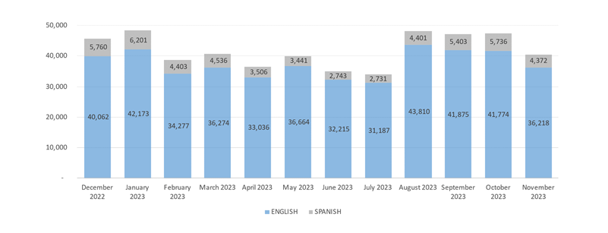
Monthly Inbound Call Volumes – English & Spanish December 2022 through November 2023

Slide 25
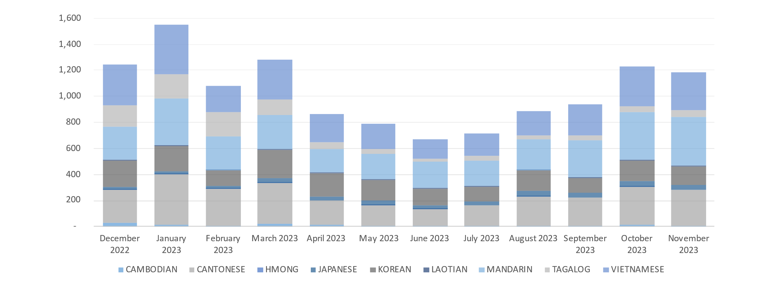
Monthly Inbound Call Volumes – English & Spanish December 2022 through November 2023

