Slide 1
California LifeLine Third Party Administrator
Presentation to the Administrative Committee
June 28, 2022

Slide 2
Renewal Process Resumption and Improvements
The Preparation:
For the period of November 11, 2021, through June 19, 2022:
350,345 subscribers pre-emptively recertified as a result of CalFresh Confirm Hub eligibility checks
    Wireless subscribers = 286,115 [28.31% of active wireless subscribers]
    Wireline subscribers = 64,230 [29.74% of active wireline subscribers]
Approval notifications to these subscribers and to their Service Providers are issued on the subscribers’ anniversary dates
Currently, subscribers checked for the first time in CalFresh Confirm Hub are the majority with positive matches rather than the subscribers who have been re-checked for successive months since the pre-emptive recertification process started in November 2021

Slide 3
Renewal Process Resumption and Improvements
Pre-emptive Recertification Value Delivered:
The 350,345 subscribers who have been pre-emptively recertified represent 28.56% of the 1,226,517 active LifeLine subscribers on June 19, 2022
Pre-emptive Recertification has mitigated the number of subscribers who must complete the Program’s renewal process when the suspension ends
These subscribers have peace of mind that their LifeLine benefits will continue for another year without the burden of completing the Program’s traditional renewal process
Pre-emptive Recertification is a proven, prudent use of Program funds thereby ensuring ratepayer funds are used in a fiscally sound manner
The external eligibility module of the TPA Platform can be leveraged as other external databases become available to validate LifeLine eligibility

Slide 4
Renewal Process Resumption and Improvements
The TPA’s Preparation:
On March 18, 2020, as a pandemic consumer protection measure, the California LifeLine annual renewal process was suspended
During the more than 27 months that the renewal process has been suspended, the TPA and CPUC have worked collaboratively to extensively improve both the renewal process and the TPA’s Platform, as will be recounted on subsequent slides
If the renewals resume on July 1, for the first month the TPA will distribute anniversary dates to start renewal processes for ~263 subscribers daily
This approach allows the TPA the opportunity to ramp up staffing
Additionally, this approach offers the TPA a controlled resumption of the renewal process for monitoring the behavior of the many TPA Platform changes

Slide 5
Renewal Process Resumption and Improvements
The Renewal Process & System Improvements:
Service Providers (SPs) can facilitate the submission of renewal forms for subscribers using the Service Provider Intake API (SPIA)
SPs using the direct application process (DAP) CheckCustomerStatus method can obtain information that a customer is in the renewal process and still has time to submit a renewal form
Targeted IVR messaging to callers within 10 days of the start of their renewal process
Day 0 and Day 35 SMS messaging for wireless subscribers (PIN is exposed in the body of the message)
Embedding PINs in links to the California LifeLine public website for Day 3 and Day 21 SMS messaging for wireless subscribers
Existing subscribers can set their own PINs and keep their PIN for future renewal periods
Participants can request their PIN be texted to their LifeLine phones

Slide 6
Renewal Process Resumption and Improvements
The Renewal Process & System Improvements Continued :
The renewal form presented for subscribers who choose to complete their renewal forms online has been changed to be more readable and user-friendly
Subscribers who choose to use the IVR to complete their renewal forms are presented with qualifying Federal public assistance programs first and then qualifying State public assistance programs. The programs are presented in order of frequency selected. For example, for Federal programs Medicaid / MediCal is presented first, then CalFresh, then SSI, etc.
Splitting Application and Renewal Task Queues so reviewers may be assigned by task volumes
Allowing renewal forms submitted through online, through the IVR, and through SPIA to be systematically approved or presented in batches for rapid processing
Subscribers who are required to complete identity verification may submit their identity documents online through the California LifeLine public website

Slide 7
CalFresh Confirm Hub
Advancements:
350,345 subscribers have been preemptively recertified which is a trouble-free process for consumers and saves ratepayer funds
Applicants who apply through SPs using SPIA do not have to provide eligibility documents when they’re matched
Mitigated risk of falsified documentation or barriers for matched applicants who did not submit acceptable documentation
A proven External Eligibility Module of the TPA’s Platform is now leverageable for other data matching sources

Slide 8
CalFresh Confirm Hub
First Hub User and CalFresh Partner Challenges:
Inconsistent weekly SNAP participant data refreshes from all counties
  CalFresh is working to establish greater reliability
Uncovered limited capacity for concurrent users performing real-time, simultaneous checks
  Joint technical team continue to enhance & refine CalFresh’s match response time performance
  CalFresh securing budget and working on purchasing more concurrent user licenses

Slide 9
Completed Initiatives 3/15/2022 – 6/27/2022
SPIA (Service Provider Intake API) Enhancements
  Effective March 14, 2022 – Expanding SPIA as a submission channel for LifeLine applications
  Effective June 16, 2022 – Extending SPIA to allow real-time updates, disconnects, removals, and requests for mailing LifeLine applications
TPA Reporting
Software update for the Qlik reporting tool to allow report developers additional features

Slide 10
Completed Initiatives 3/15/2022 – 6/27/2022 Continued
TPA Call Center Platform Enhancements
        Requiring CSRs to select a “call reason” and “sub-reason” for every inbound call. This enhancement supports internal reporting
        Requiring a SSN4 value for reviewer screens
        Automating CalFresh Confirm Hub checks for all applications received
TPA Platform Waste, Fraud, and Abuse Prevention Enhancements
      Adding 4 new queries to detect subscribers who may be violating the “one benefit per independent economic household” Program rule
      Providing USAC information about accounts that USAC identified as subscribers who may be violating the “one benefit per independent economic household” Program rule that the TPA has determined by manual review to not be in violation of Program rules (whitelisted accounts)

Slide 11
Completed Initiatives 3/15/2022 – 6/27/2022 Continued
Participant Communications
      Enhanced Service Provider comparison functionality for consumers using the California LifeLine public website
      Updating the California LifeLine public website content to reflect extension of the renewal process freeze through June 30, 2022
      Updating the California LifeLine public website content with the Household Income Limits effective for June 1, 2022 through May 31, 2023
      Customizing the Digital IDV SMS text message content to include the actual due date for completing the IDV process
      Adding a reminder SMS text message for wireless participants who have not completed the IDV process during the first 5 calendar days of the process

Slide 12
Upcoming Initiatives
Modernizing the Print Framework to enable subscriber communication experience improvements to overcome today’s limitations to add, refine and revise content to forms & letters
Personal Identification Number (PIN) removal and an identity authentication replacement to meet AB 74 Compliance (requires Print Framework Modernization as prerequisite for form & letter changes)
De-coupling the Household Worksheet (IEH) from the renewal process so it is a stand-alone process triggered by a service address change (requires Print Framework Modernization and AB 74 Compliance for form & letter changes)
Updating SMS text message opt in and opt out policies and procedures
Registration and tracking of SPs’ representatives who interact with consumers
Registration and tracking of Benefit Qualifying Persons (BQP)
Implementing a monthly connections and conversions report for wireline SPs

Slide 13
Upcoming Initiatives
Geo-coding active LifeLine subscribers for reporting
Preventing mid-service term Tribal changes across all Service Provider update methods
Implementing a unique identifier for each LifeLine participant
Deploying a customer portal

Slide 14
Program and Operations Reports
Program Participation – Active LifeLine Subscribers
Wireless: Response & Approval Rates – All Form Types
Wireline: Response & Approval Rates – All Form Types
Top 5 Denial Reasons
Subscriber Counts by Service Provider (Top 5)
Enrollment Eligibility Methods – Program versus Income
Enrollment Eligibility Methods – By Qualifying Program
Form Received Channel Volumes
Call Volumes – English & Spanish
Call Volumes – Other Supported Languages
Inbound Call Reasons

Slide 15
Program Participation – Active LifeLine Subscribers
  Current: Total Number of Active LifeLine Subscribers as of June 1, 2022
  Wireless: 1,008,727
  Wireline: 217,187
  Total: 1,225,914
  March 2022 AC Meeting: Total Number of Enrolled Subscribers as of March 1, 2022
  Wireless: 983,764
  Wireline: 224,163
  Total: 1,207,927

Slide 16
Wireless: Response & Approval Rates – All Form Types
Month Year | # Total | # Responded | % Responded | # Approved | % Approved
Totals | 1,498,508 | 1,385,471 | 92.5% | 1,350,208 | 97.4%
Jun 2021 | 85,127 | 78,048 | 91.7% | 76,214 | 97.7%
Jul 2021 | 93,297 | 83,842 | 89.9% | 82,466 | 98.4%
Aug 2021 | 102,419 | 93,657 | 91.4% | 91,656 | 97.9%
Sep 2021 | 98,190 | 90,627 | 92.3% | 87,154 | 96.2%
Oct 2021 | 102,379 | 95,064 | 92.9% | 92,945 | 97.8%
Nov 2021 | 196,981 | 188,749 | 95.8% | 186,537 | 98.8%
Dec 2021 | 161,133 | 151,696 | 94.1% | 147,728 | 97.4%
Jan 2022 | 140,933 | 128,853 | 91.4% | 125,099 | 97.1%
Feb 2022 | 113,648 | 103,681 | 91.2% | 100,880 | 97.3%
Mar 2022 | 133,923 | 122,806 | 91.7% | 120,676 | 98.3%
Apr 2022 | 129,808 | 119,641 | 92.2% | 116,910 | 97.7%
May 2022 | 140,670 | 128,807 | 91.6% | 121,943 | 94.7%

Slide 17
Wireline: Response & Approval Rates – All Form Types
Month Year | # Total | # Responded | % Responded | # Approved | % Approved
Totals | 84,371 | 73,640 | 87.3% | 71,885 | 97.6%
Jun 2021 | 2,365 | 1,117 | 47.2% | 869 | 77.8%
Jul 2021 | 1,885 | 872 | 46.3% | 715 | 82.0%
Aug 2021 | 1,949 | 900 | 46.2% | 779 | 86.6%
Sep 2021 | 1,749 | 887 | 50.7% | 733 | 82.6%
Oct 2021 | 1,687 | 790 | 46.8% | 629 | 79.6%
Nov 2021 | 24,609 | 23,730 | 96.4% | 23,590 | 99.4%
Dec 2021 | 23,537 | 22,643 | 96.2% | 22,498 | 99.4%
Jan 2022 | 14,103 | 13,272 | 94.1% | 13,174 | 99.3%
Feb 2022 | 3,659 | 3,089 | 84.4% | 2,990 | 96.8%
Mar 2022 | 3,178 | 2,444 | 76.9% | 2,287 | 93.6%
Apr 2022 | 2,605 | 1,737 | 66.7% | 1,612 | 92.8%
May 2022 | 3,045 | 2,159 | 70.9% | 2,009 | 93.1%

Slide 18
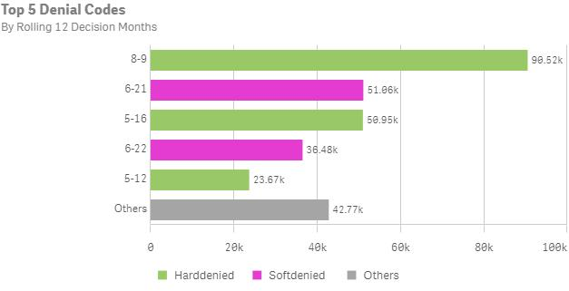
Top 5 Denial Reasons: June 2021- May 2022
Denial Code | Type | Form | Description
8-9 | Hard Denial | Application | We do not have evidence that the Application Form was returned to us.
6-21 | Correctible Denial | Application | We do not have evidence that the Application Form was returned to us.
5-16 | Hard Denial | Application | Applicant failed to return ID verification form and documentation (for IDV)
6-22 | Correctible Denial | Application | Documentation provided does not meet the eligibility guidelines.
5-12 | Hard Denial | Application | An active phone number and service start date was not provided by the carrier within 30 days from receipt of status code 53

Slide 19
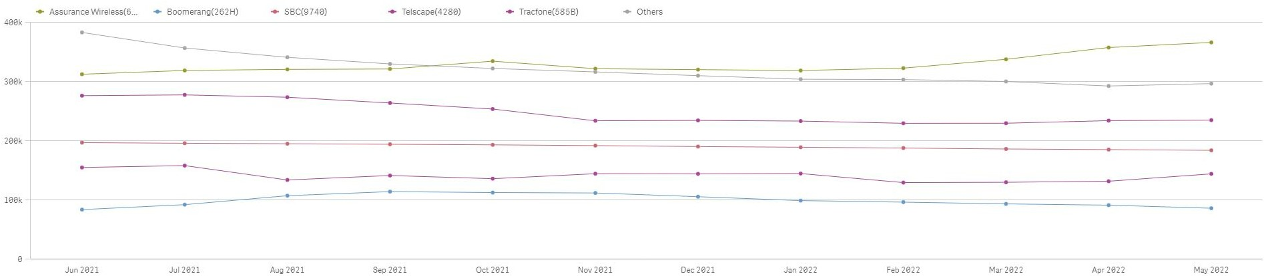
Subscriber Counts by Service Provider (Top 5)

Slide 20
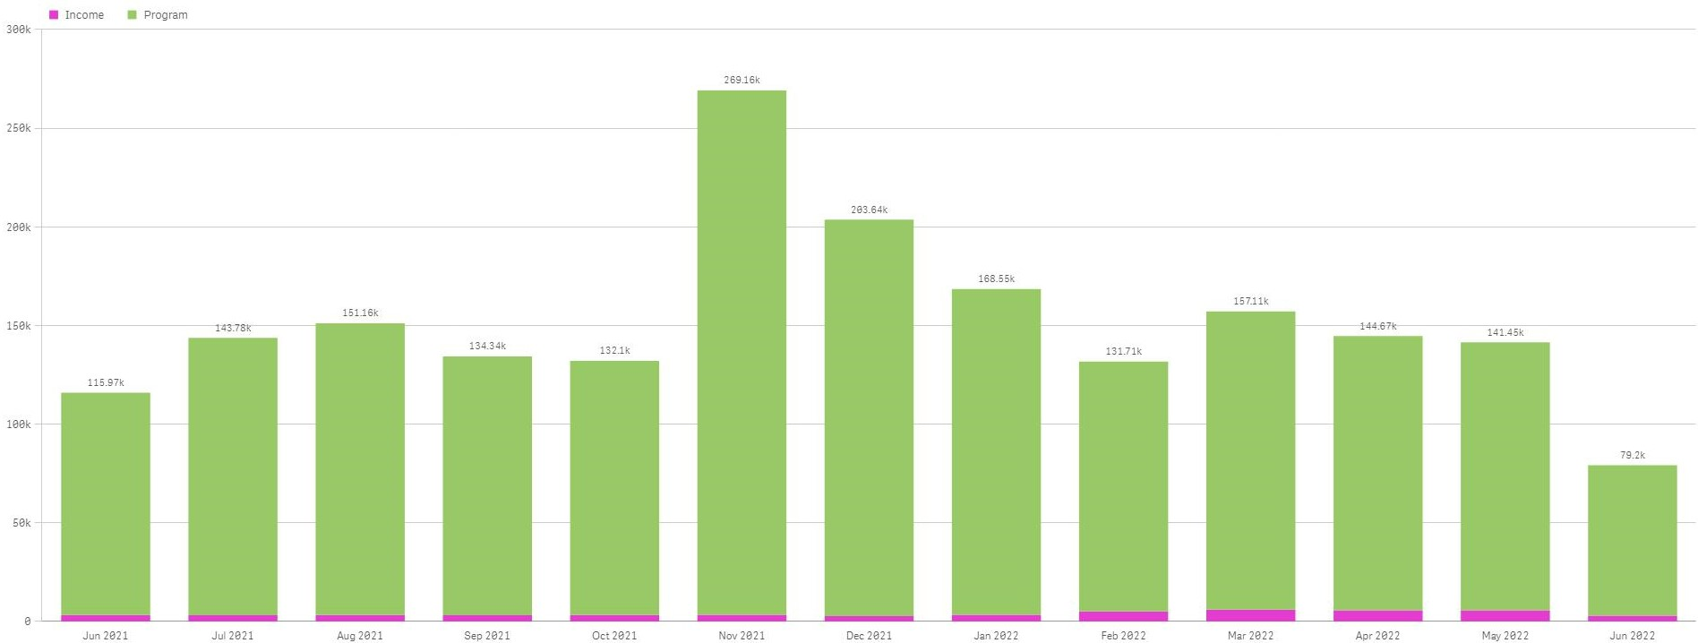
Enrollment Eligibility Methods – Program versus Income

Slide 21
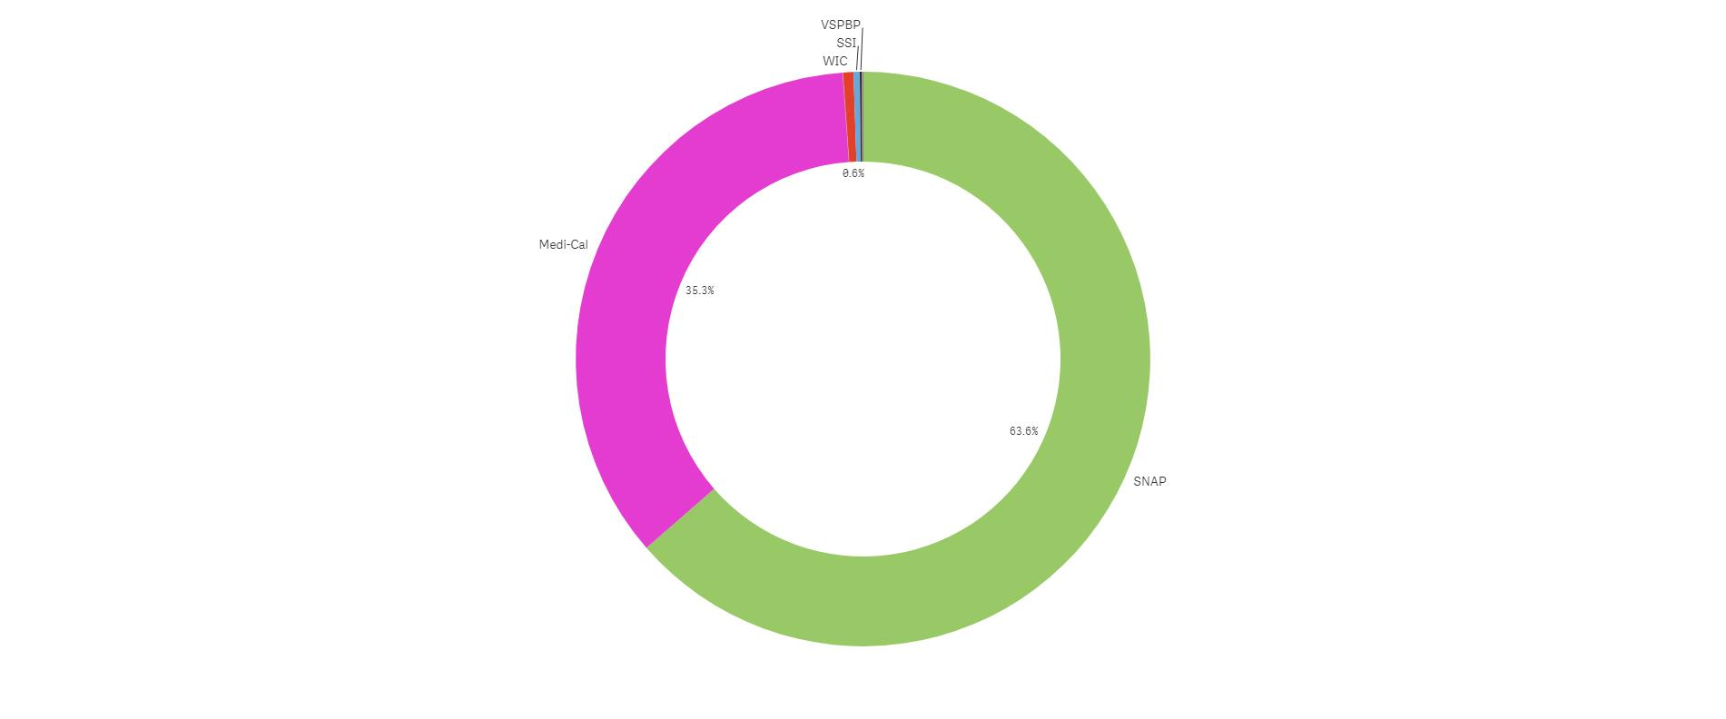
Enrollment Eligibility Methods – By Qualifying Program

Slide 22
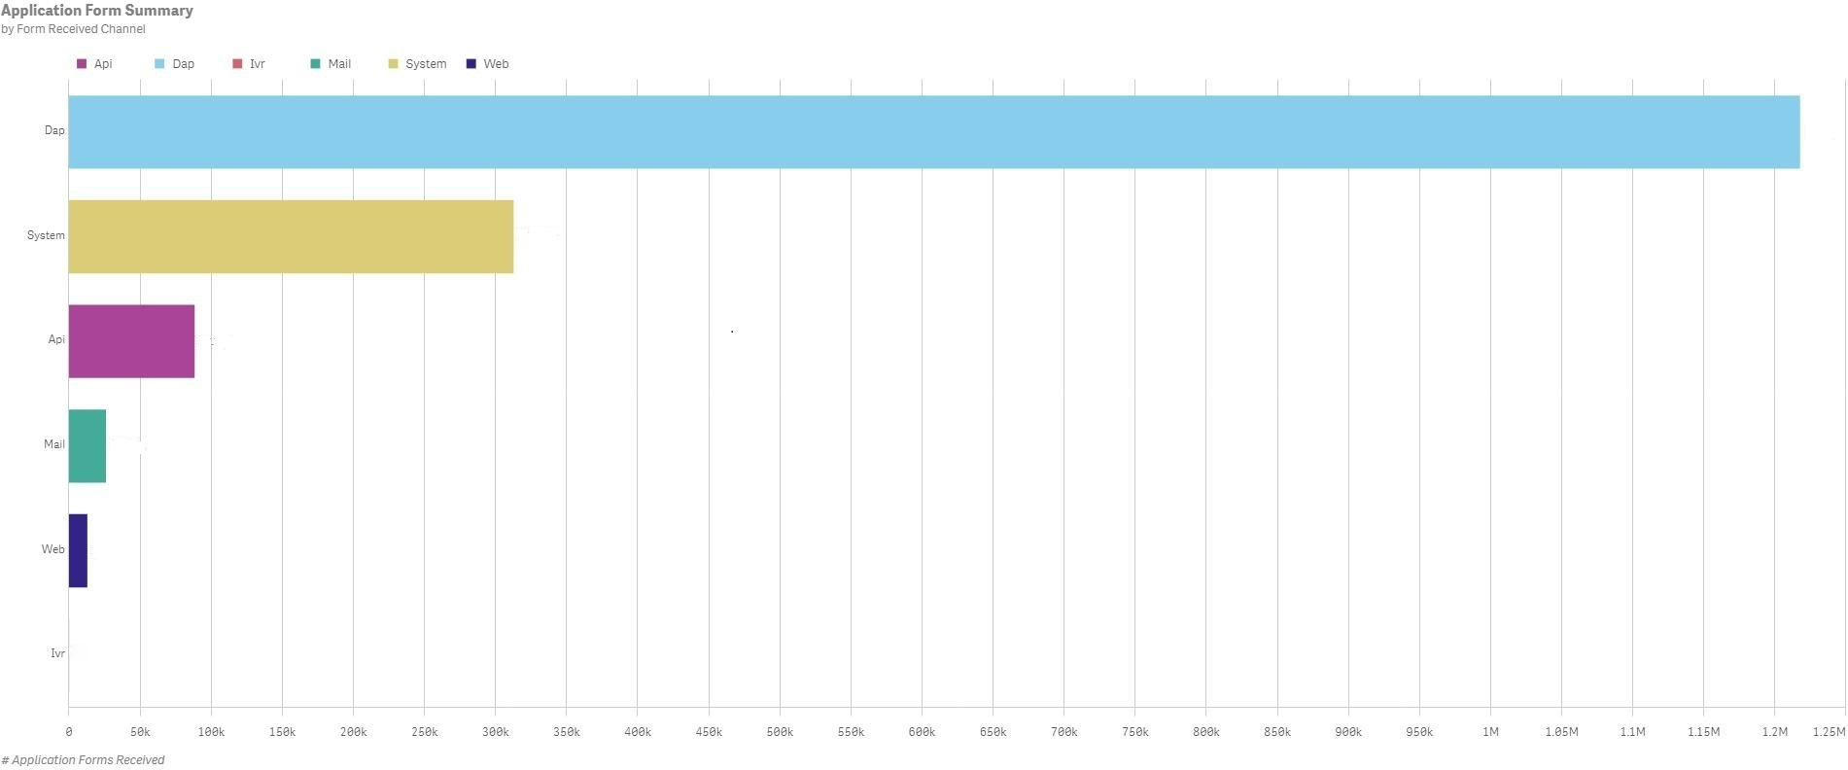
Form Received Channel Volumes: June 2021- May 2022
1.22m
312.78k
88.39k
25.99k
12.89k

Slide 23
Call Volumes: English & Spanish

Slide 24
Call Volumes: Other Supported Languages

Slide 25
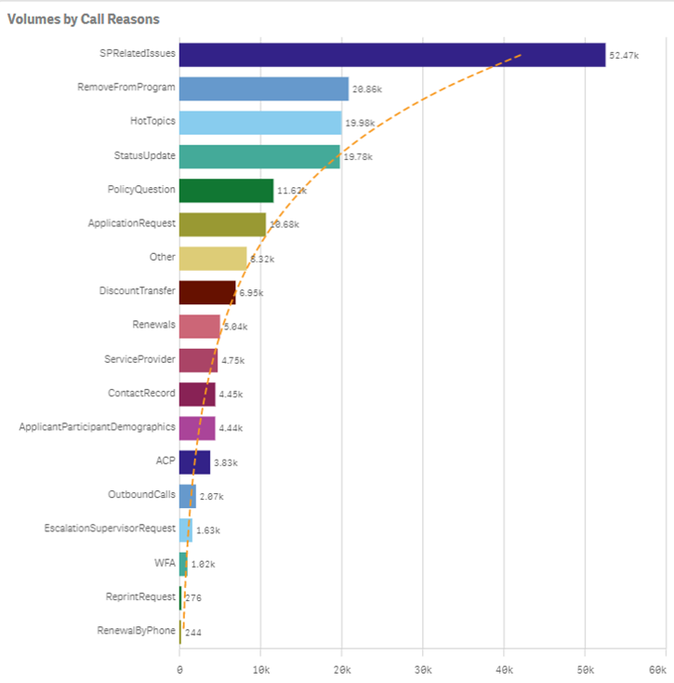
Inbound Call Reasons

