Slide 1

California Teleconnect Fund (CTF) Program
Application Process & ECAP Demo
Presented by CTF Staff

Slide 2
The program aims to bring every Californian direct access to advanced communications services in their local communities, particularly those with lower rates of internet adoption and greater financial need. – California Teleconnect Fund

Slide 3
Agenda Items
Background
Entities, criteria, and timelines
eCAP demonstration
Required documentations
Qualifying services worksheet
Deficiencies
Determination
Conclusion

Slide 4
CTF Background

Slide 5
CTF Backgound
The CTF provides discounts of up to 50% off on eligible telecommunication services.
Since it’s inception in 1996, the CTF has supported over 14,000 participants by bridging the Digital Divide through access and adoption to broadband services at discounted rates in their community.
Entities eligible for the CTF are California schools, libraries, community colleges, Government Owned and operated hospitals, community-based organizations and members of the California Telehealth Network.
Prior to 2023, entities would apply for CTF by completing and filling out an application form specific to their entity and mailing the form to the Commission.

Slide 6
CTF- Application Entities, Criteria, Eligibility, & Timelines

Slide 7


Application Entities & Criteria
Schools
Libraries
Government Hospitals & Clinics
Community Colleges
Public Schools-No requirement
Private Schools- must be a verifiable non-profit organization
Certified by the CA State Library
Operated by municipal or local government
N/A
Public Schools- None
Private Schools- $50 Million Endowment Cap
No Revenue Cap
No Revenue Cap
No Revenue Cap
Services: Elementary, pre-school, or K-12 academic instruction
Services: Direct broadband access to community members
Services: Only locations in CA that provide direct healthcare services to the community
Services: Educational services to community members
CDS Code
N/A
CDPH/ Healthcare License Number
MIS Code

Slide 8

Application Criteria Cont.
Community Based Organizations (CBOs)
Healthcare CBO’s
2-1-1 Service Providers
501-c3 Organization
501-c3 Organization
501-c3 Organization
$5 Million Revenue Cap
$50 Million Revenue Cap
None
Performs Qualifying Services per CTF rules
Provides direct licensed healthcare services to public
Offers 2-1-1 services as the primary function
www.cpuc.ca.gov/ctf
Majority Board members in CA
Majority board members in CA
Majority board members in CA
Not a religious organization
Licensed Healthcare Personnel on site
Be a designated 2-1-1 service provider by the CPUC via an adopted Resolution.
CDPH/ Healthcare License Number

Slide 9
Application Timeline
CTF Analyst Receives Application
CTF Analyst Reviews Application
CTF Analyst Issues Deficiency Requests
**if required
CTF Analyst Approves or Rejects Application
Applicant
Submits Application in ECAP
Applicant
Awaits During Review Process
Applicant
Receives Deficiency Notices and Re-submits Application
Applicant
Receives Notification of Approved or Rejected Application

Slide 10
CTF- Application ECAP Demonstration

Slide 11


HOW TO FILE APPLICATIONS IN ECAP
The following will be CTF staff presenting live demonstrations for applicants submitting CTF applications.
eCAP Web Portal:
https://ecap.cpuc.ca.gov/
Community-Based Organizations (CBOs)
CTF staff will provide a live demonstration
Public and Private Schools
CTF staff will provide a live demonstration
Libraries, Community Colleges, Government Hospitals, 2-1-1 Service Providers
For these remaining entities, CTF staff will go through screenshots of how to file an application.
Healthcare Community-Based Organizations (HCBOs)
CTF staff will provide a live demonstration
Organizations must utilize eCAP to manage their participation in the CTF program, including for submitting applications, maintaining contact information, and completing eligibility recertifications.

Slide 12
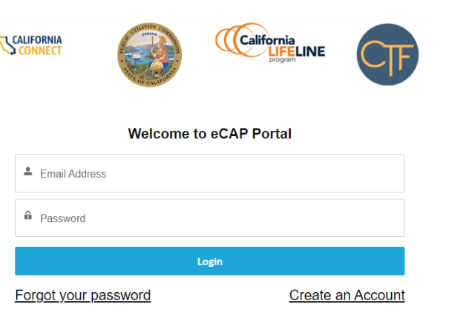
General Information

Slide 13
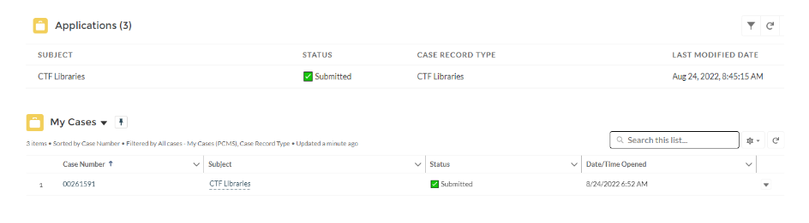
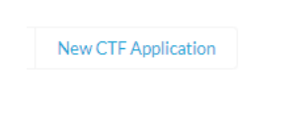
List of submitted applications/cases
Applications in applicant queue are called “cases”
Each application is assigned a case number
To begin a new application, applicant will click “New CTF Application” button.

Slide 14
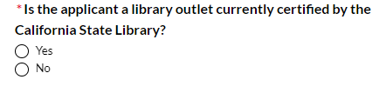
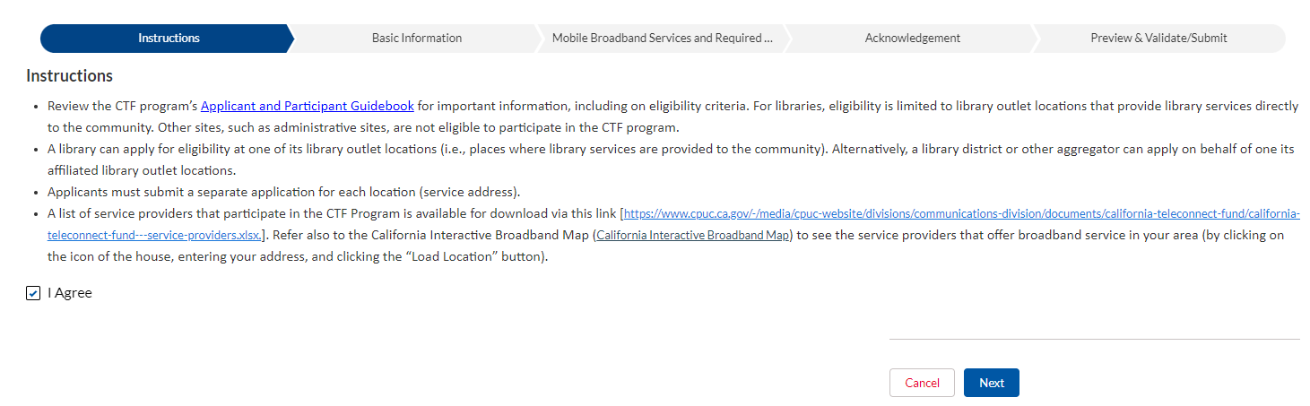
Libraries
The system will present a series of questions
Select “No” until you see the question that best describes your organization and select “Yes”
When selected, click “Next” to continue to the Instructions tab.
The Instructions tab provides information and indicates the required documents to submit with the application.

Slide 15
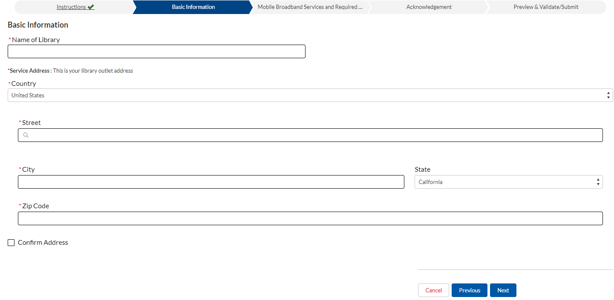
Libraries: Basic Information

Slide 16
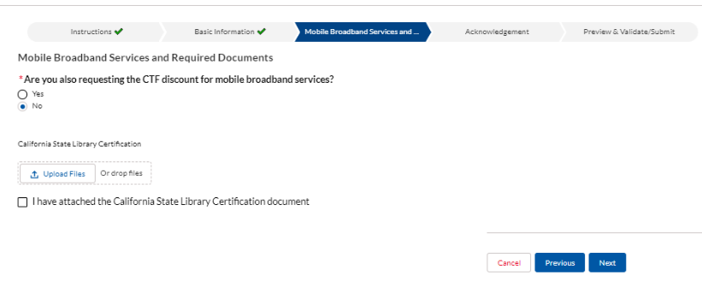
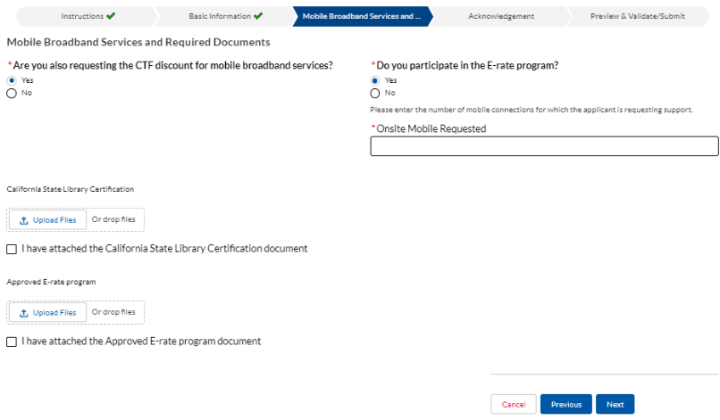
Libraries: Mobile Broadband Services
The next tab will ask if the Applicant is requesting the CTF discount for mobile broadband services
If “No” select it, upload the library certification document and click ‘Next’
If “Yes,” indicate if the organization participates in the E-rate program, enter the # of onsite mobile connections requested, and upload all required documents
Click Next to continue.

Slide 17
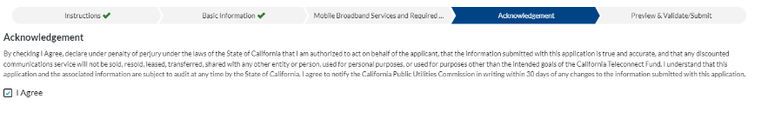
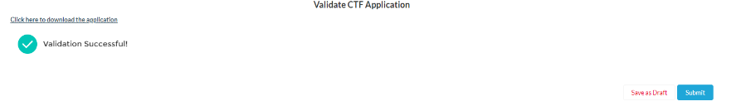
Libraries: Terms & Conditions and Submission
Acknowledging Terms & Conditions:
Application Validation:

Slide 18
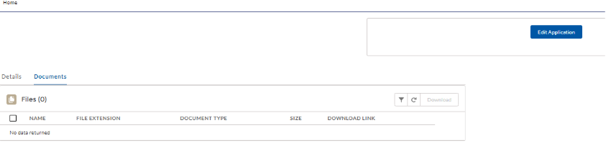
Libraries: “Save for Later”
If the application is saved for a later submittal, it will appear in the list of applications with a status of Draft and will be assigned a Case Number
To submit the application, click the Case Number link to navigate to the Details page
To add a document, click on the Edit Application Button
The tabs for the Application process appear again. From here you can go to the appropriate tab if changes to the application are needed, or you can click the “Preview & Validate/Submit” tab.

Slide 19
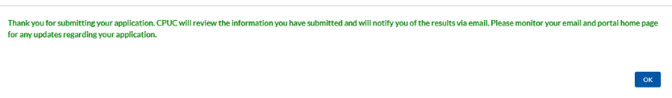
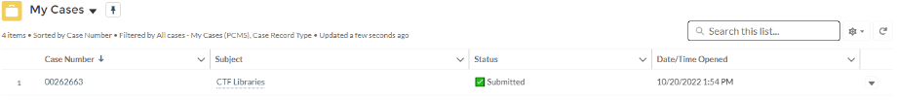
Libraries: Submission
Once submitted, a confirmation message will appear, and the application’s status will change to Submitted.
An email will also be sent to the email address(es) of all users listed in the account.
To return to the homepage, click the Home link in the upper left-hand corner.
To view details of the case, click the Case Number on the homepage.

Slide 20


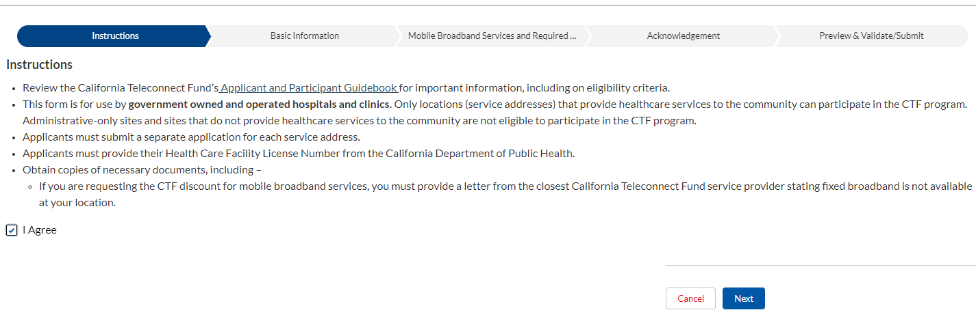
Government Hospitals-Clinics
Click New CTF Application
The system will present a series of questions
Select “No” until you see the question that best describes your organization and select “Yes”
When selected, click “Next” to continue to the Instructions tab
1.
2.
3.

Slide 21
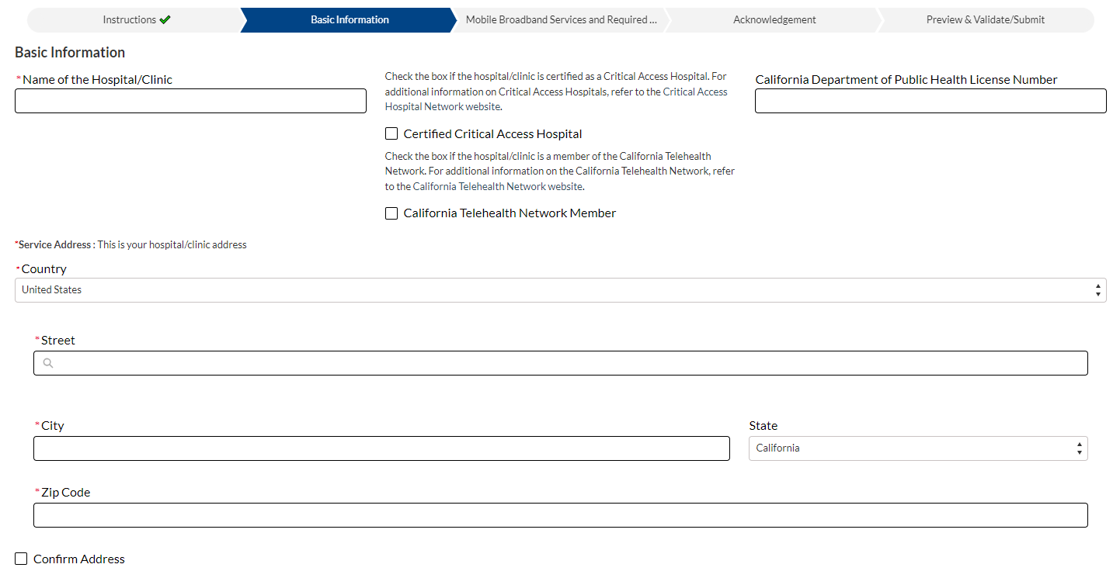
Government Hospitals-Clinics: Basic Information

Slide 22
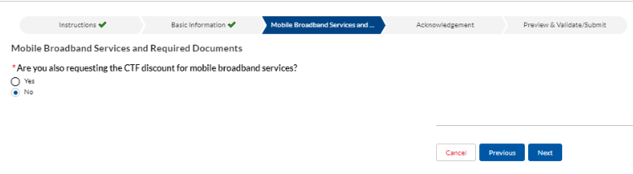
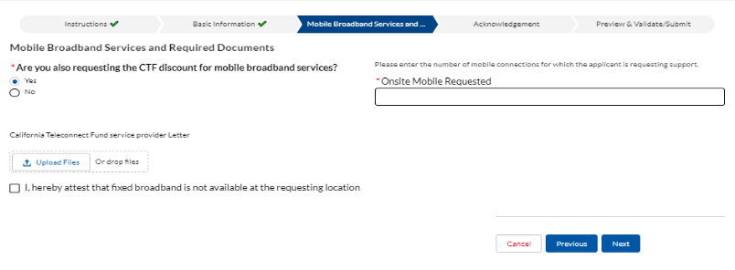
Government Hospitals-Clinics: Mobile Broadband Services
The next tab will ask if the Applicant is requesting the CTF discount for mobile broadband services
If “No,” select it and click Next.
If “Yes,” enter the # of onsite mobile connections requested, and upload the required document.
Click Next to continue.

Slide 23
Government Hospitals-Clinics: Terms & Conditions and Submission
Acknowledging Terms & Conditions:
Application Validation:

Slide 24
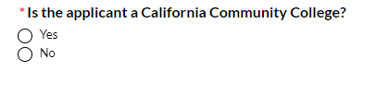
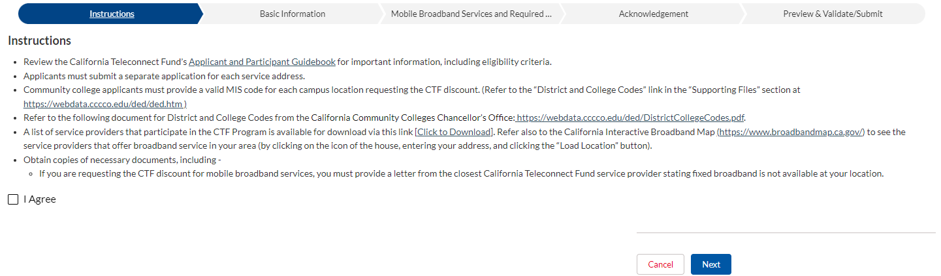
Community Colleges
Click New CTF Application
The system will present a series of questions
Select “No” until you see the question that best describes your organization and select “Yes”
When selected, click “Next” to continue to the Instructions tab
1.
2.
3.

Slide 25
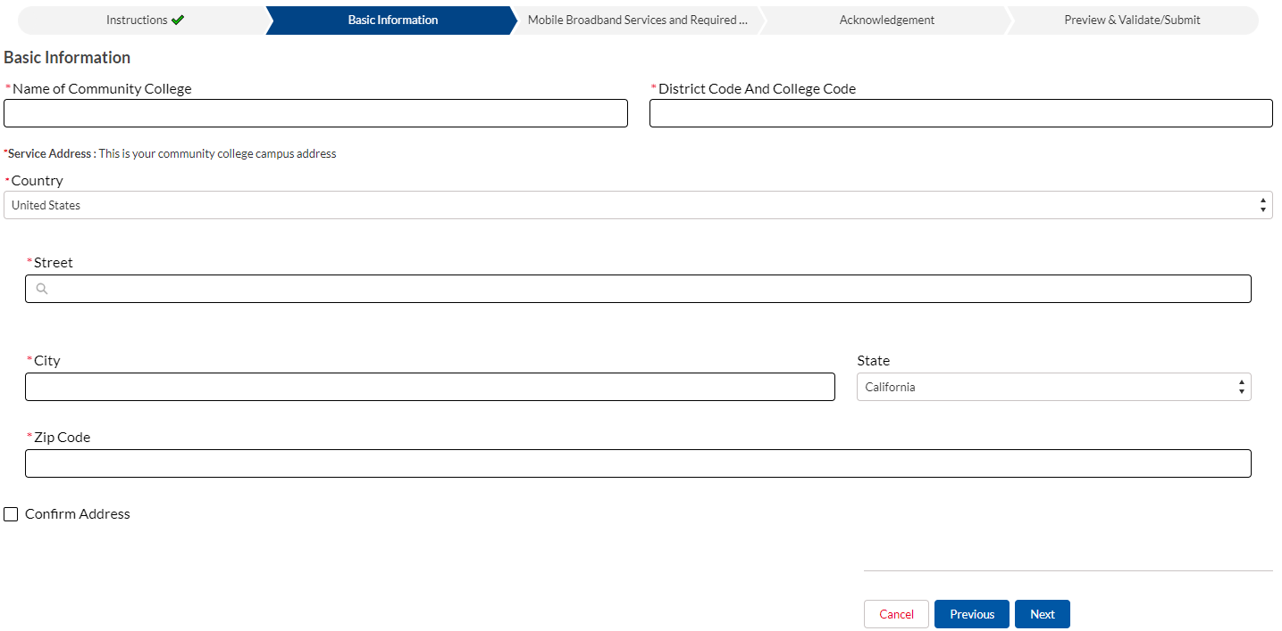
Community Colleges: Basic Information

Slide 26
Community Colleges: Mobile Broadband Services
The next tab will ask if the Applicant is requesting the CTF discount for mobile broadband services
If “No,” select it and click Next.
If “Yes,” enter the # of onsite mobile connections requested, and upload the required document.
Click Next to continue.

Slide 27
Community Colleges: Terms & Conditions and Submission
Acknowledging Terms & Conditions:
Application Validation:

Slide 28
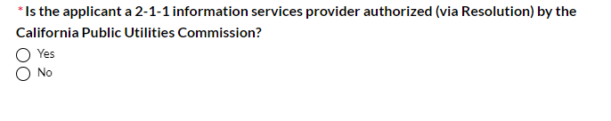
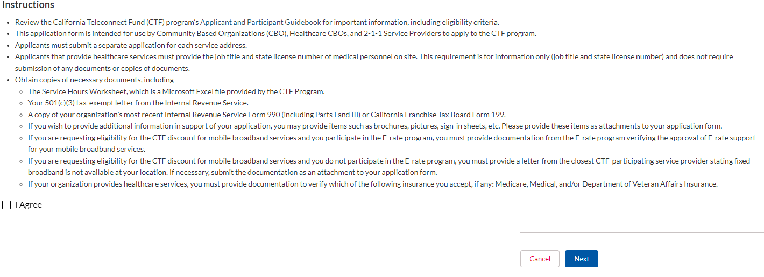
2-1-1 Service Provider
Click New CTF Application
The system will present a series of questions
Select “No” until you see the question that best describes your organization and select “Yes”
When selected, click “Next” to continue to the Instructions tab
1.
2.
3.

Slide 29
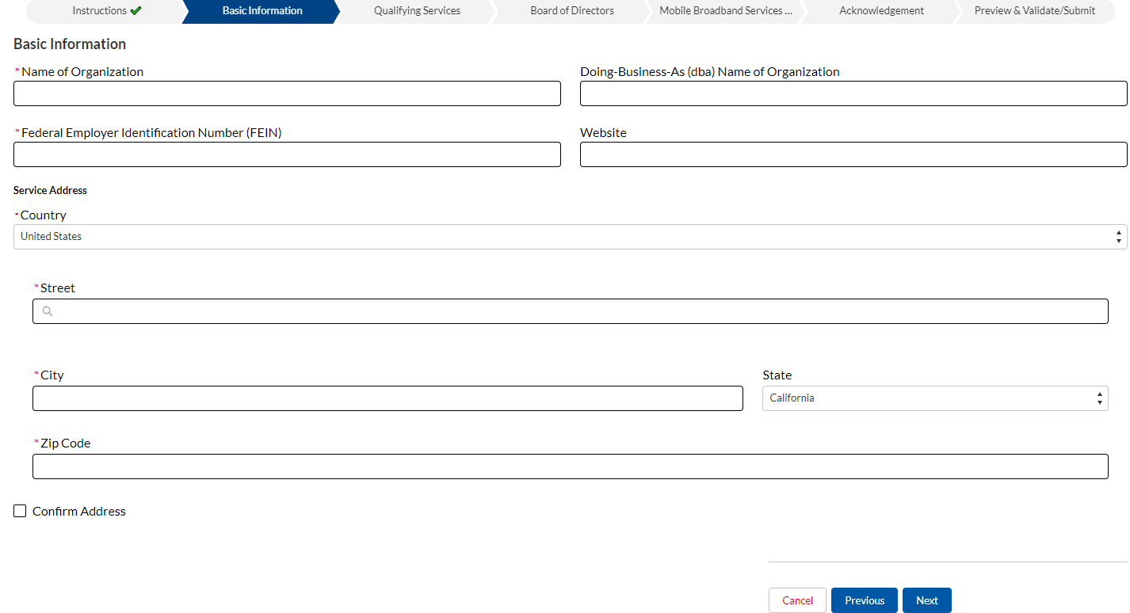
2-1-1 Service Providers: Basic Information

Slide 30
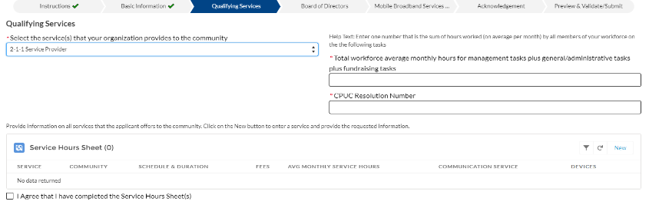
2-1-1 Service Provider: Qualifying Service Tab
The Qualifying Service tab asks for specific information related to services provided.
From the drop-down menu, the user selects “2-1-1 Service Provider.” Enter the information in the field on the right-hand side.

Slide 31
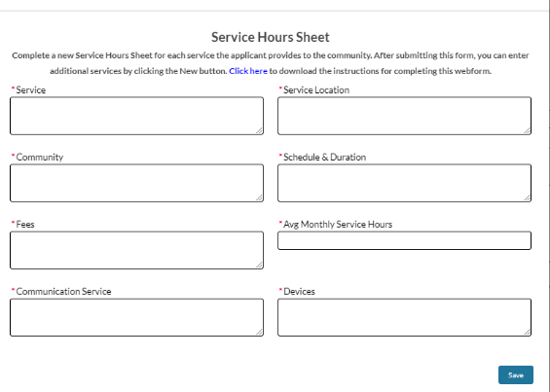
2-1-1 Service Provider: Service Hours Sheet
For Service Hours Sheet section, click on the “New” button and provide the requested information on the populated sheet and click ‘Save.’
Complete a new Service Hours Sheet for each service. After submitting this sheet (see screenshot below), you can enter additional services by clicking the New button again

Slide 32
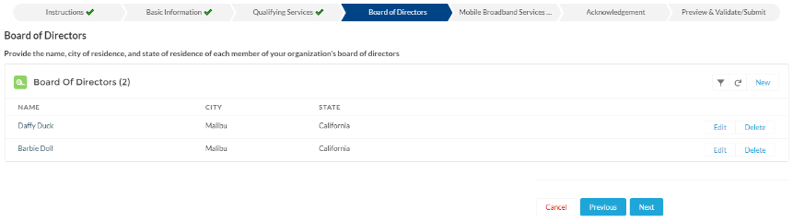
2-1-1 Service Providers: Board of Directors
Provide information on the organizations’ Board of Directors
Click “New” to add that information (at least one member must be added)
Enter additional names by clicking the “New” button again

Slide 33
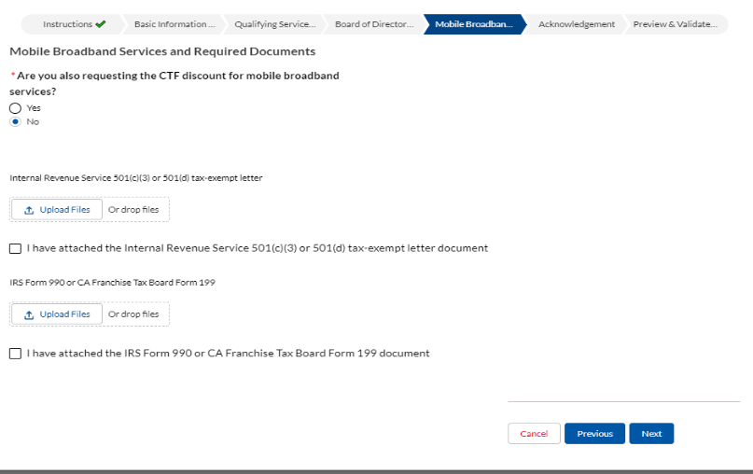
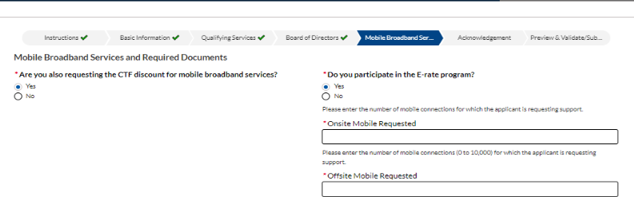
2-1-1 Service Providers: Mobile Broadband Services
For Mobile Broadband Services and Required Documents Tab, indicate if this organization is requesting the CTF discount for mobile broadband services
If No, select ‘No,’ and upload the required documents. Click Next to continue.
If Yes, indicate if the organization participates in the E-rate program, enter the # of onsite and/or offsite mobile requested, and upload all required documents. Click Next to continue

Slide 34
2-1-1 Service Providers: Terms & Conditions and Submission
Acknowledging Terms & Conditions:
Application Validation:

Slide 35
Live Demonstration

Slide 36
CTF- Application Required Documentation

Slide 37
Documentation
Public and Private K-12 Schools
  County District School (CDS) code
  Form 501(C) 3- IRS Tax Exempt (Private School)
  Form 990 (Private School)
Libraries
  Letter from State Librarian
Community Colleges
  Management Information System (MIS) code
Government Hospital and Clinics
  A valid healthcare license and identification number

Slide 38
Documentation ( cont.)
Community Based Organization (CBO)
  Form 501(C) 3 or Form 501(d)
  Form 990
  Qualifying Service Worksheet
HealthCare Community Based Organization
  Form 501(C) 3 or Form 501(d)
  Form 990
  Qualifying Service Worksheet
  Healthcare Insurance document or Healthcare fee document
  California Department of Public Health License Number
  Name, titles, and license numbers for all Licensed Medical Personnel on site.

Slide 39
Completeness in Documentation
All documents submitted through eCAP must be updated/most recent and accurate.
Submit your applications under the correct category.
All required fields in eCAP must be completed.
Participants must keep their contact information current and up to date.
Participants must respond to CTF staff’s inquiry and/or requests for supporting documents.
Failure to submit a completed application under the correct category with complete and accurate documents will result in rejection of your application.

Slide 40
Best Ways to Gathering Documents
Understanding the requirements
Organize your documents
Verify for accuracy
Create a checklist

Slide 41
Submitting Documentation
Gather all necessary documents
Login to eCAP
Upload Documentations and submit your application through eCAP
Complete all required fields on eCAP

Slide 42
CTF- Application Qualifying Services Worksheet

Slide 43
Purpose of Qualifying Services Worksheet
Determination of eligibility
Calculation of discounts
Application process
Compliance

Slide 44
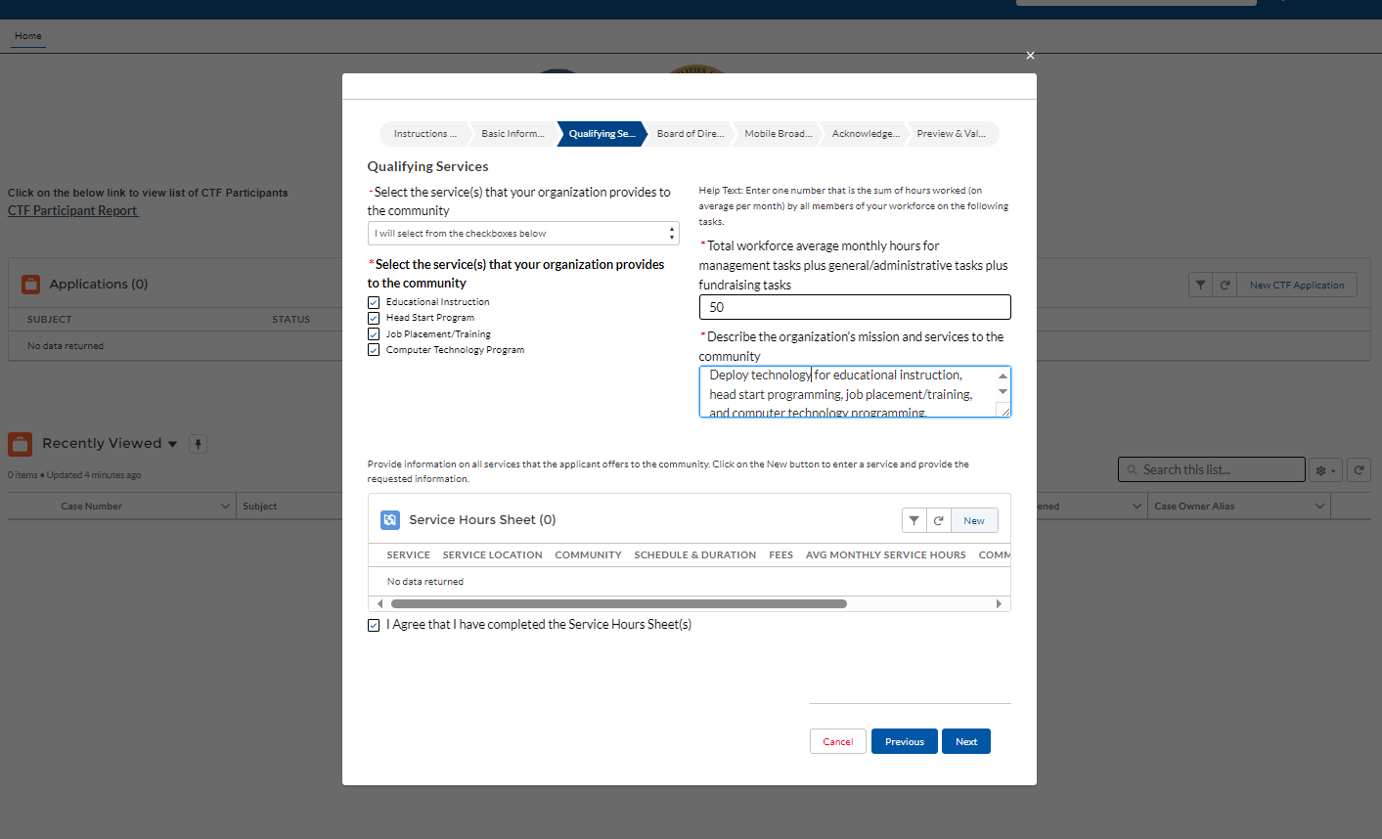
How To Fill Out The Worksheet Accurately
Notes:
Services Definition: The activities, benefits, or programs a CBO provides to members of the community. Services includes both Qualifying Services and non-Qualifying Services. This slide provides an image of a sample eCAP screenshot of an application, while an applicant is midstream in working through eCAP forms. Here is what I want you to take away from the visuals of this eCAP form:
Applicants select the service or service(s) the organization provides to the community, from a menu of options
Applicants disclose the number of non-Qualifying service hours ---Non-Service Hours equals a CBO’s average monthly Management & General Hours plus its average monthly Fundraising Hours.4 (Fundraising Hours are the number of hours a CBO Workforce works appealing for financial support for the CBO. Management & General Hours are the number of hours a CBO Workforce works on administrative and management tasks, excluding work to provide Services to the community.)
Applicants describe the mission and services to the community
Applicants provide data which composes the Service Hours Sheet. Applicants start data entry by clicking “new”.
After data entry, applicants check the box to agree that they have completed the Service Hours Sheet or Sheets.
After checking that box, applicants click “next.”

Slide 45
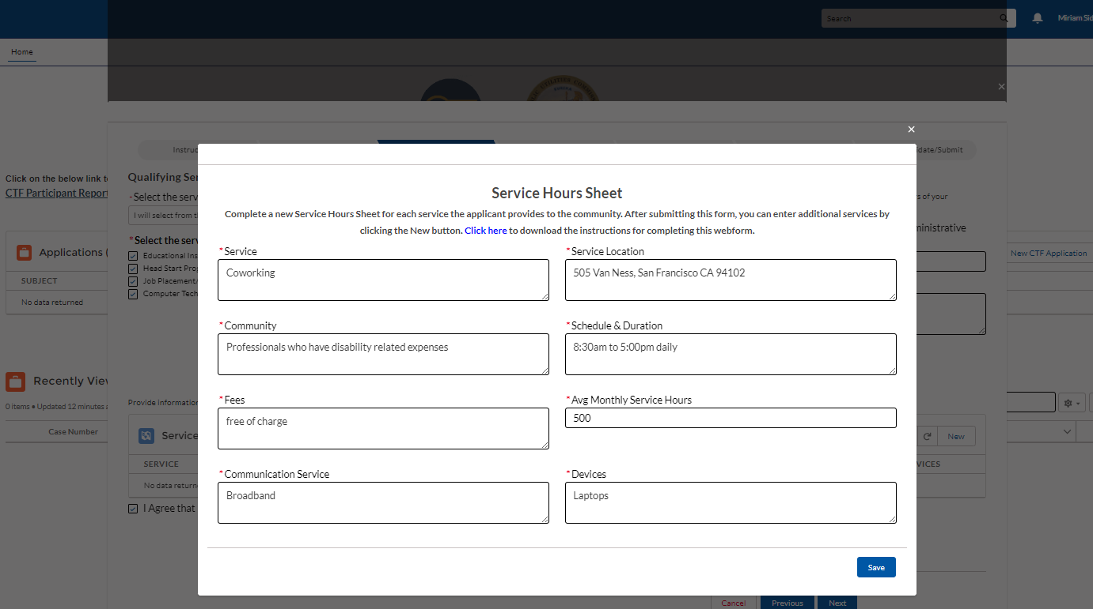
How To Fill Out The Worksheet Con’t
Notes:
Here is more detail regarding Data Entry. The form before you facilitates applicants’ providing detailed information on each Service. Applicants provide the following data points for each service: Service; Service Location; Community; Schedule & Duration; Fees; Average Monthly Service hours; Communication Service(e.g., DSL, fiber broadband, satellite broadband, Internet access); Devices (e.g., desktop computers, tablets).

Slide 46
Common Qualifying Services
Data Transmission Services
Internet Access
Integrated Services Digital Network
Notes:
Community Technology Programs: A program to provide the community training and/or access to technology and advanced communication services. Eligible Community Technology Programs must include the use of a CTF-eligible telecommunication service by community members
Educational Instruction: Regular, ongoing, preschool or K-12 academic educational or instructional programs that can also include ESL and language education, literacy, job training, technology instructions and information on public benefit and social services programs eligibility and access.3 Eligible CBO’s that offer Educational Instruction must also make available to community members access to CTF-eligible telecommunication service.
Job Placement: A regular and ongoing Service to provide community members with assistance in obtaining employment, including activities related to job recruiting and placement. Eligible Job Placement Services must include the use of a CTF-eligible telecommunication service by community members.
Job Training: A regular and ongoing Service to provide community members with training or skill-building for the purpose of obtaining employment. Job Training services do not include a CBO’s work to train its own CBO Workforce. The subject matter of eligible Job Training includes trade and vocational education and Community College curriculum but excludes training exceeding the level of an Associate of Arts or equivalent degree from a California Community College. Eligible Job Training Services must include the use of a CTF-eligible telecommunication service by community members.

Slide 47
CTF- Application Deficiencies
Notes:
Community Technology Programs: A program to provide the community training and/or access to technology and advanced communication services. Eligible Community Technology Programs must include the use of a CTF-eligible telecommunication service by community members.
Educational Instruction: Regular, ongoing, preschool or K-12 academic educational or instructional programs that can also include ESL and language education, literacy, job training, technology instructions and information on public benefit and social services programs eligibility and access.3 Eligible CBO’s that offer Educational Instruction must also make available to community members access to CTF-eligible telecommunication service.
Job Placement: A regular and ongoing Service to provide community members with assistance in obtaining employment, including activities related to job recruiting and placement. Eligible Job Placement Services must include the use of a CTF-eligible telecommunication service by community members.
Job Training: A regular and ongoing Service to provide community members with training or skill-building for the purpose of obtaining employment. Job Training services do not include a CBO’s work to train its own CBO Workforce. The subject matter of eligible Job Training includes trade and vocational education and Community College curriculum but excludes training exceeding the level of an Associate of Arts or equivalent degree from a California Community College. Eligible Job Training Services must include the use of a CTF-eligible telecommunication service by community members.

Slide 48
Deficiencies and Delays
Incomplete information
Incorrect or inaccurate information
Eligibility issues
Failure to provide supporting documents

Slide 49
Deficiencies and Delays Con’t
Service provider approval
Non-compliance
Incomplete cost details

Slide 50
CTF- Application Determination

Slide 51
CTF’s Determination
Eligibility Criteria
Organizational type
Non-profit status
Application Submission
Completed application
Accurate supporting documents
Documents verifications
Determination - approval/ineligible/rejection
Approval and Determination
Notification

Slide 52
Application Review Process
Document submission
Document verification
Eligibility assessment
Review financial information
Check compliance with program rules
Approval/ineligible/rejection

Slide 53
Conclusion

Slide 54
Conclusion
CTF accepts applications from nonprofit CBOs, schools, libraries, healthcare CBOS, government hospitals and clinics, and community colleges.
Applicants to the CTF program must login to eCAP and submit a completed application with update and accurate supporting documents.
Once application is submitted, staff is notified and starts its review and evaluation of the application and supporting documents.
CTF program will make a determination of approved, ineligible, or rejected.

Slide 55
Questions?

Slide 56
Resources
Information on the previous webinar is
Available at:
Program Outreach and Education
For more information:
https://www.cpuc.ca.gov/CTF
CTF Applicant & Participant Guidebook
Available on our website in English, Spanish, and Chinese
E-CAP Frequently Asked Questions:
Help - FAQs (ca.gov)

Slide 57

For questions regarding the CTF program and application process, please reach out to us at CTFHelp@cpuc.ca.gov.

